Slide 1
WELCOME TO WORSHIP

Slide 3
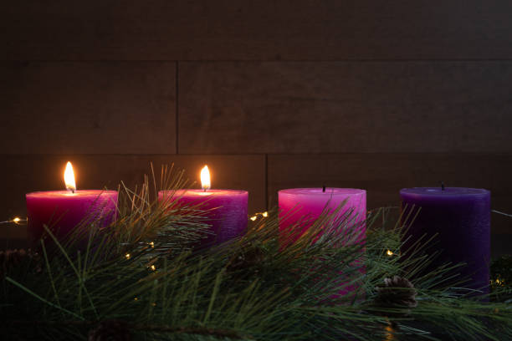
SECOND SUNDAY OF ADVENT READINGS: PREPARATION

Slide 4
“A voice of one calling: ‘In the wilderness prepare the way for the Lord; make straight in the desert a highway for our God. Every valley shall be raised up, every mountain and hill made low; the rough ground shall become level, the rugged places a plain.
And the glory of the Lord will be revealed, and all people will see it together. For the mouth of the Lord has spoken.’” Isaiah 40:3-5

Slide 5
Prayer for Lighting the Second Candle - Peace:
"God of peace, as we light the second Advent candle of peace, may Your peace fill our hearts and our world. Help us to be peacemakers in our relationships and communities. In Jesus' name, we pray. Amen."

Slide 6
Lord Jesus, Light of light,
you have come among us.
Help us who live by your light
to shine as lights in your world.
Glory to God in the highest. Amen

