Slide 1
MAN OF HONOUR
JABEZ
1 Chronicles 4:9-10

Slide 3
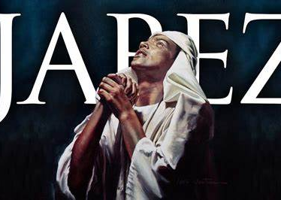
JABEZ THE PERSON
INTRODUCTION
BACKGROUND
1 Chron. 2:55

Slide 4
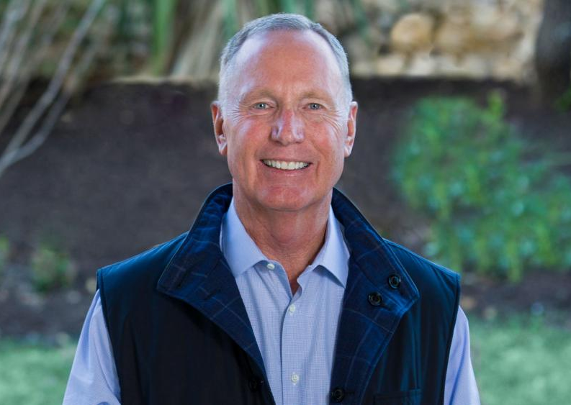
THE PRAYER
In Max Lucado’s book Facing Your Giants, he writes, “Two types of thoughts continually vie for your attention. One proclaims God’s strengths; the other lists your failures.”

Slide 5
THE PRAYER
“He discovered that ordinary, personal everyday needs can be brought to God: he 'cried out' and God granted his request” (New International Encyclopedia of Bible characters
How We Can Pray Like Jabez?
“But you, beloved, building yourselves up in your most holy faith and praying in the Holy Spirit”(Jude 1:20).

Slide 6
THE PERSON – THE GOD OF ISRAEL
“Jabez cried out to the God of Israel”
Begins by acknowledging God is God….
1st PRAYER-“This is the confidence we have in approaching God: that if we ask anything according to his will, he hears us” (1 John 5:14).
“Look to the LORD and his strength; seek his face always” (1 Chr 16:11.
-“Watch and pray so that you will not fall into temptation. The spirit is willing, but the flesh is weak” (Matthew 26:41).
-“-“The LORD is near to all who call on him, to all who call on him in truth” (Psalm 145:18).

Slide 7
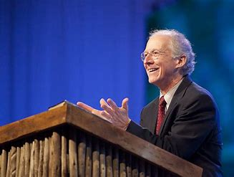
THE PRAYER
John Piper writes, "Lay hold on God for some great biblical vision for your life on this earth and don't let go until you have it from His merciful hand."

Slide 8
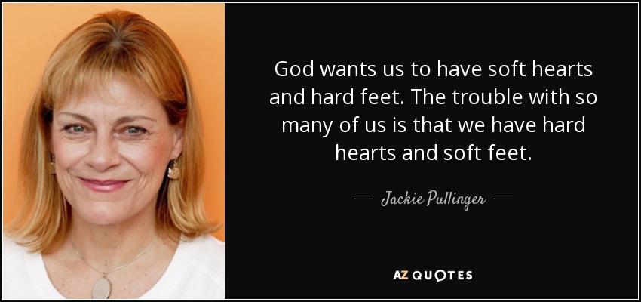
THE PETITION – (Plea)
“Oh, that you would bless me indeed.”
2nd PRAYER
“You have
Not
because
You do not
Ask”
James 4:2,3

Slide 9
THE PROVISION
“& enlarge my territory”
“He must increase & I must decrease” John the Baptist
Territory is not just practical land
It is Impacting the Kingdom
Reclaim some of the land satan has taken from you
“That God would enlarge our hearts,” wrote Matthew Henry, “is to be our desire & prayer”
3rd PRAYER

Slide 10
THE PRESENCE
“that Your hand be with me”
Jabez understood the power of God to guide
He leads through any circumstance & trials
He leads in the right path to good purpose.
Jesus said, “I will never leave you or forsake you even to the end of the age.”
4th PRAYER

Slide 11
THE PROTECTION
“keep me from harm that I might be free from pain”
“Special attention is given him because his faith was triumphant over His name, which was regarded as possessing almost magical powers” New Bible Commentary
“Sticks & stones………”
“He seems to have lived in dread that his name would be prophetic…so he prayed about it and God granted his request.” (New International Encyclopaedia of Bible Characters) 5th PRAYER

Slide 12
THE PROMISE-KEEPER
“& God granted him his request.”
God still answers Prayers!
For us to pray as Jabez did, we must first recognize who God is in our lives
Do we know that He alone is the source of all blessings?
Do we recognize that God can give us the appropriate blessings if we ask Him for them?
6th prayer is PRAISE

Slide 14
MEANING & LESSONS FROM THIS PRAYER
1. THE PERSON – “Jabez cried out to the God of Israel”
2. THE PLEA – “Oh, that you would bless me indeed.”
3. THE PROVISION – “& enlarge my territory”
4. THE PRESENCE – “that Your hand be with me”
5. THE PROTECTION – “keep me from harm that I might be free from pain”
6. THE PROMISE-KEEPER – “& God granted him his request.”
7th CLOSING PRAYER

