Slide 1
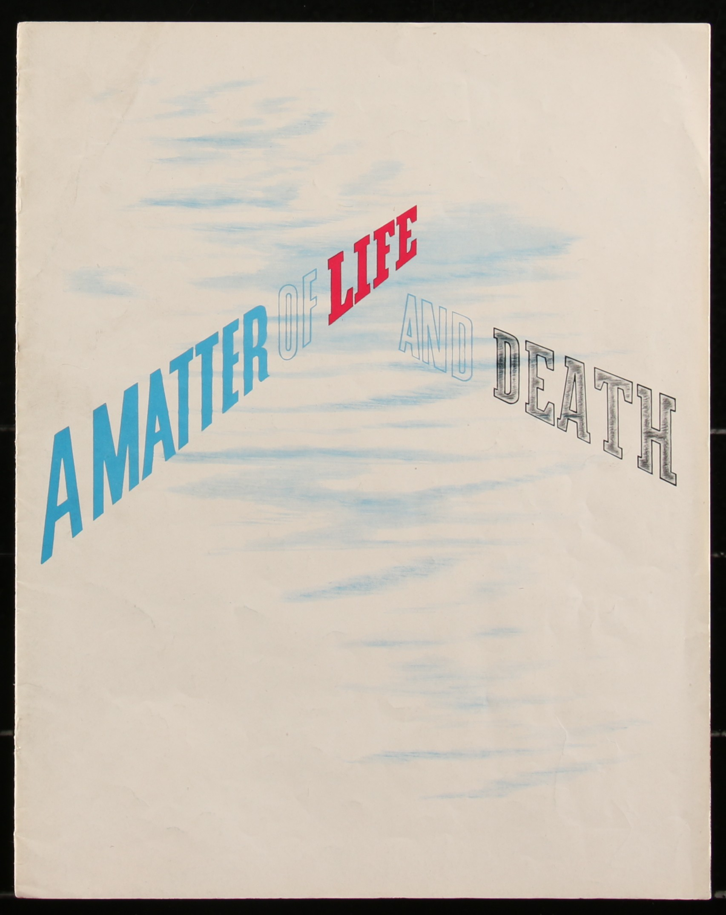

Slide 8
What happens to us when we die?

Slide 9
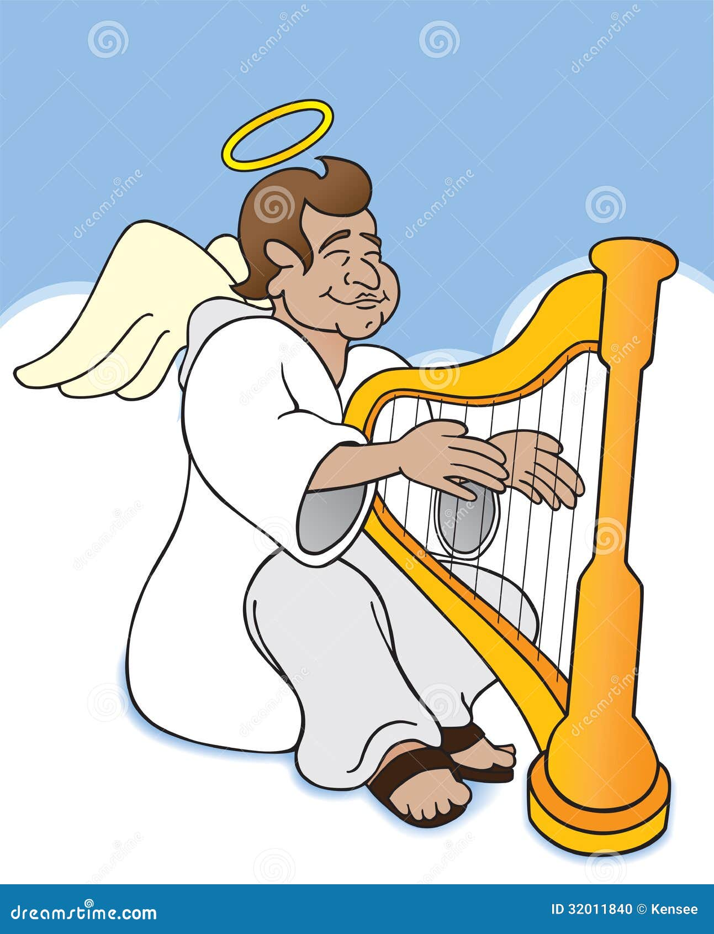
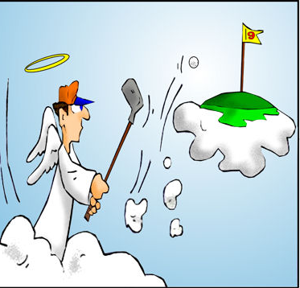
What happens to us when we die?
Reincarnation
Annihlation
Judgement
Not got a clue
Heaven or hell?

Slide 12
Die in your sins | Die in the Lord

Slide 13
Die in your sins They will be thrown outside, into the darkness, where there will be weeping and gnashing of teeth. | Die in the Lord No eye has seen, what no ear has heard, and what no human mind has conceived - the things God has prepared for those who love him

Slide 14
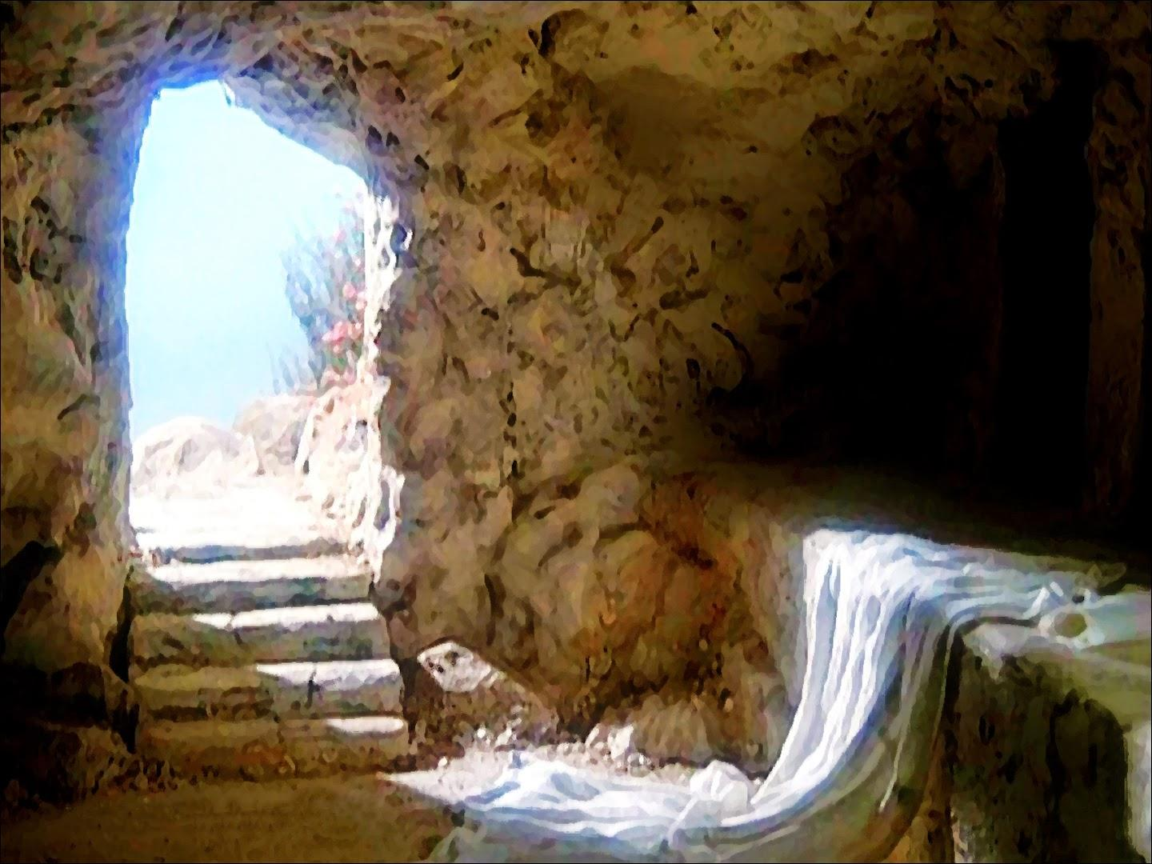
What evidence do we have for life after death?

Slide 15
1 Corinthians 15 v 1-8
Now, brothers, I want to remind you of the gospel I preached to you, which you received and on which you have taken your stand. By this gospel you are saved, if you hold firmly to the word I preached to you. Otherwise, you have believed in vain.
For what I received I passed on to you as of first importance: that Christ died for our sins according to the Scriptures,

Slide 16
that he was buried, that he was raised on the third day according to the Scriptures, and that he appeared to Cephas, and then to the Twelve. After that, he appeared to more than five hundred of the brothers and sisters at the same time, most of whom are still living, though some have fallen asleep. Then he appeared to James, then to all the apostles, and last of all he appeared to me also, as to one abnormally born.

Slide 17
How has death been defeated?
1 Corinthians 15 v 54-57
When the perishable has been clothed with the imperishable, and the mortal with immortality, then the saying that is written will come true: “Death has been swallowed up in victory.”
“Where, O death, is your victory? Where, O death, is your sting?”
The sting of death is sin, and the power of sin is the law. But thanks be to God! He gives us the victory through our Lord Jesus Christ.

Slide 18
Hebrews 2 v 9
But we do see Jesus, who was made lower than the angels for a little while, now crowned with glory and honour because he suffered death, so that by the grace of God he might taste death for everyone.

Slide 19
How can I be sure of eternal life?
John 5 v 24
Very truly I tell you, whoever hears my word and believes him who sent me has eternal life and will not be judged but has crossed over from death to life.
Romans 6 v 23
For the wages of sin is death, but the gift of God is eternal life in Christ Jesus our Lord.

Slide 20
John 3 v 16
God so loved the world that he gave his one and only Son, that whoever believes in him shall not perish but have eternal life.
John 3 v 36
Whoever believes in the Son has eternal life, but whoever rejects the Son will not see life, for God’s wrath remains on them.

Slide 21
How should we prepare for death?
Repent and believe

Slide 22
Don’t be afraid
Hebrews 2 v 14&15
By his death he might break the power of him who holds the power of death – that is, the devil – and free those who all their lives were held in slavery by their fear of death

Slide 23
Psalm 23 v 4
Even though I walk through the valley of the shadow of death, I will fear no evil, for you are with me

Slide 24
Realise where your real home is

Slide 25
Philippians 3 v 20
But our citizenship is in heaven, and we eagerly await a Saviour from there, the Lord Jesus Christ

Slide 26
Practise dying daily!
Matthew 16 v 24- 26
Then Jesus said to his disciples, ‘Whoever wants to be my disciple must deny themselves and take up their cross and follow me. For whoever wants to save their life will lose it, but whoever loses their life for me will find it. What good will it be for someone to gain the whole world, yet forfeit their soul?

Slide 27
Galatians 2 v 20
I have been crucified with Christ and I no longer live, but Christ lives in me. The life I now live in the body, I live by faith in the Son of God, who loved me and gave himself for me.

Slide 28
Be baptised

Slide 29
Focus on Jesus
Hebrews 12 v1&2
Therefore, since we are surrounded by such a great cloud of witnesses, let us throw off everything that hinders and the sin that so easily entangles. And let us run with perseverance the race marked out for us, fixing our eyes on Jesus, the pioneer and perfecter of faith

Slide 30
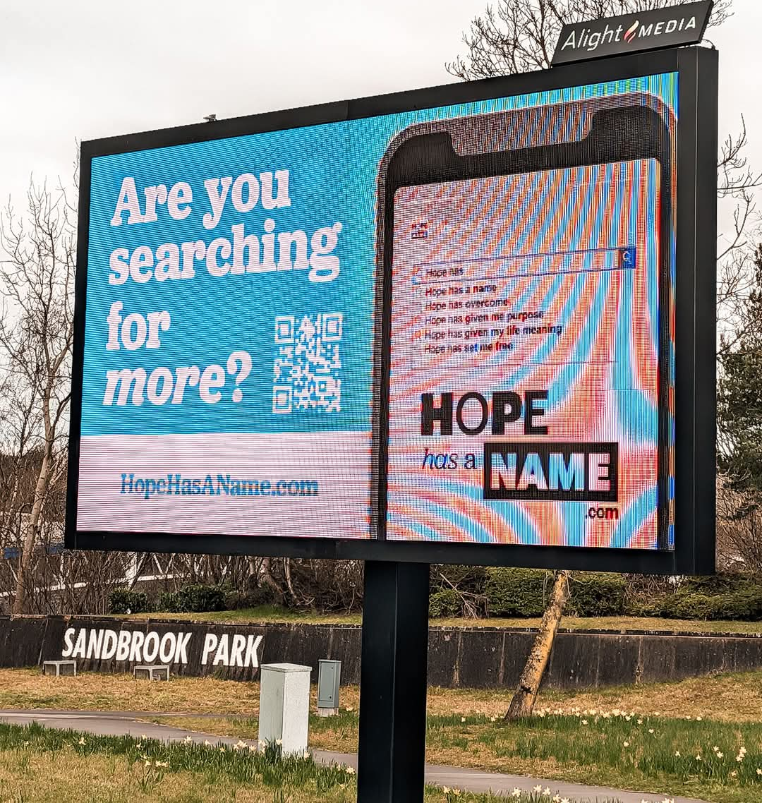
Hope has a name

