Slide 1
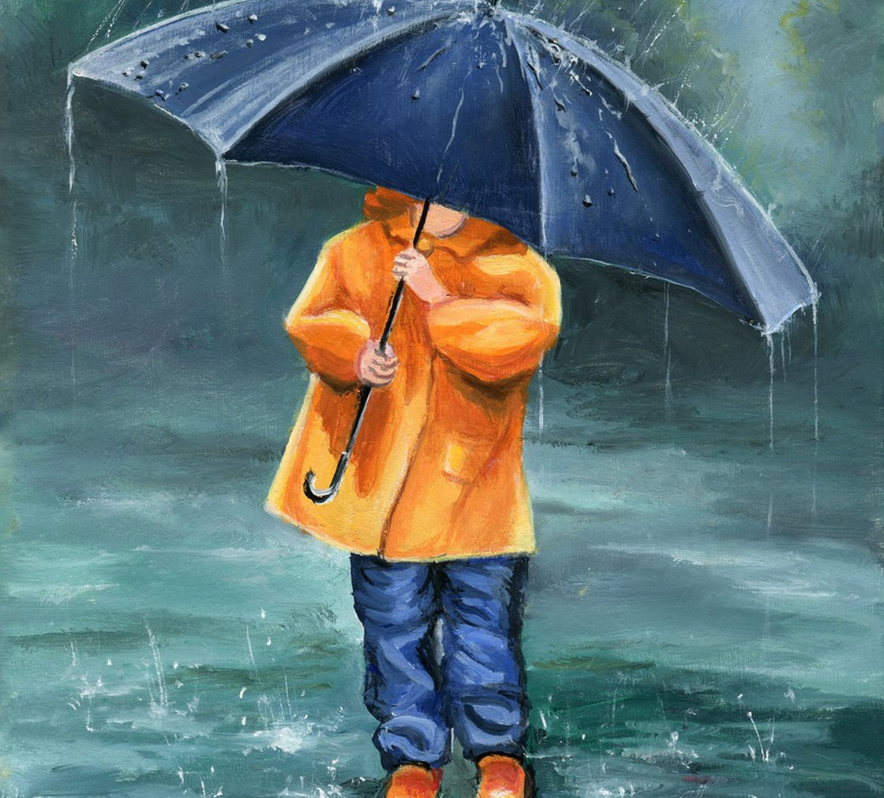

Slide 2
Jeremiah 17

Slide 4
⁵ This is what the Lord says: “Cursed is the one who trusts in man, who draws strength from mere flesh and whose heart turns away from the Lord. ⁶ That person will be like a bush in the wastelands;
they will not see prosperity when it comes. They will dwell in the parched places of the desert, in a salt land where no one lives. ⁷ “But blessed is the one who trusts in the Lord, whose confidence is in him. ⁸ They will be like a tree planted by the water that sends out its roots by the stream.

Slide 5
It does not fear when heat comes; its leaves are always green. It has no worries in a year of drought and never fails to bear fruit.” ⁹ The heart is deceitful above all things and beyond cure. Who can understand it? ¹⁰ “I the Lord search the heart and examine the mind, to reward each person according to their conduct, according to what their deeds deserve.” ¹¹ Like a partridge that hatches eggs it did not lay are those who gain riches by unjust means.

Slide 6
When their lives are half gone, their riches will desert them, and in the end they will prove to be fools. ¹² A glorious throne, exalted from the beginning, is the place of our sanctuary. ¹³ Lord, you are the hope of Israel; all who forsake you will be put to shame. Those who turn away from you will be written in the dust because they have forsaken the Lord, the spring of living water.
¹⁴ Heal me, Lord, and I will be healed; save me and I will be saved, for you are the one I praise

Slide 9
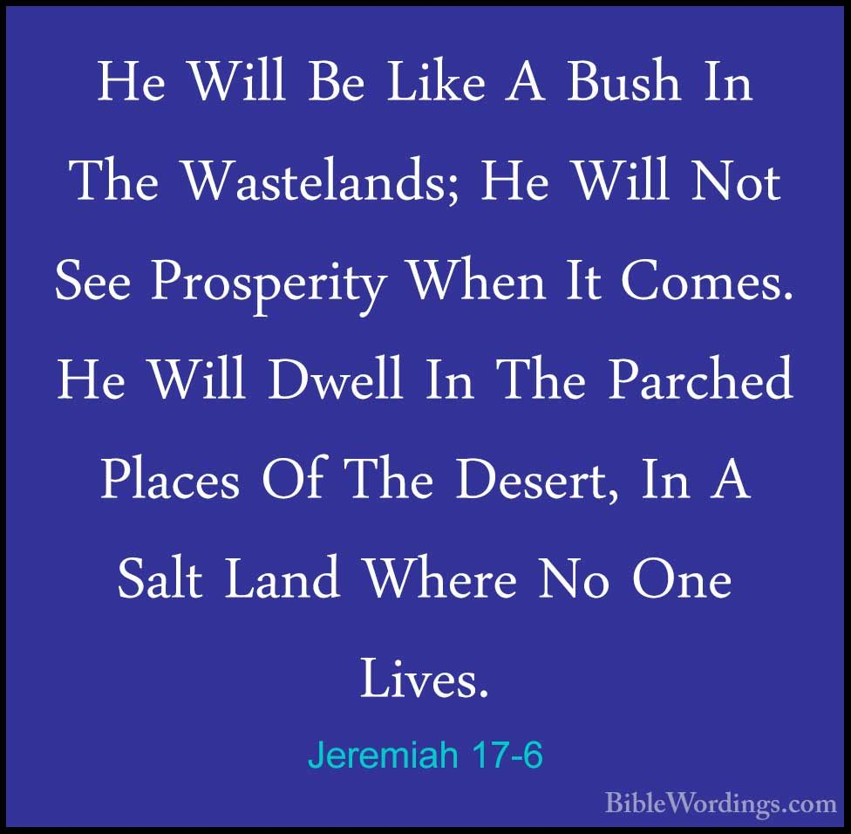

Slide 10
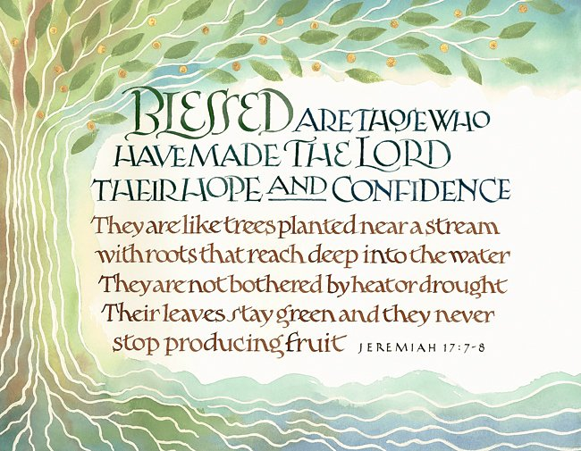

Slide 11
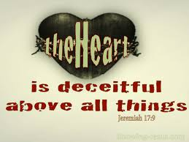

Slide 12
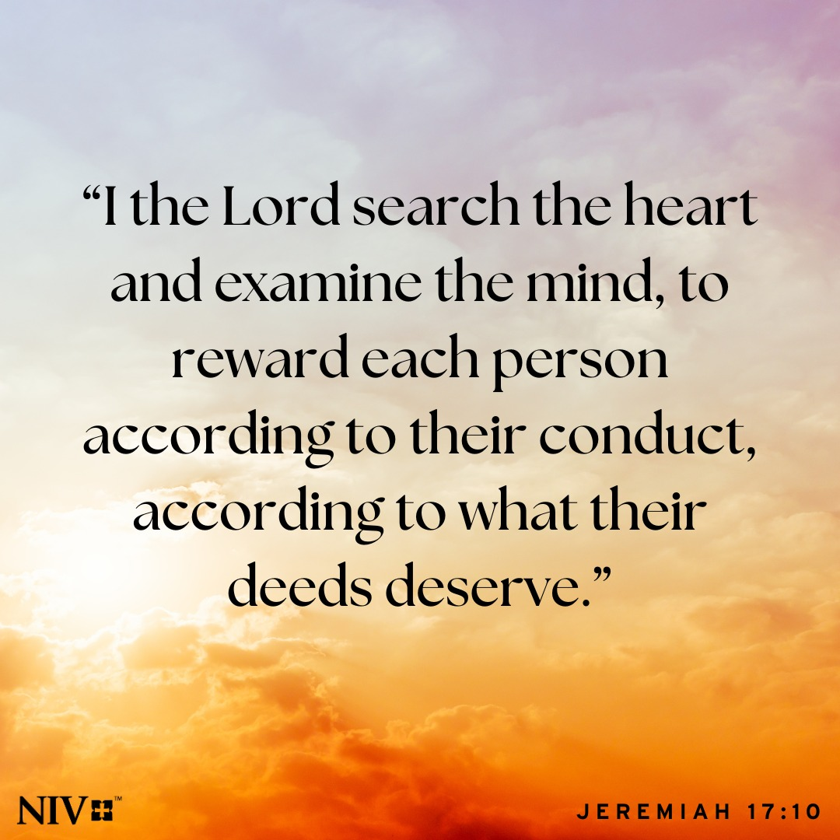

Slide 13
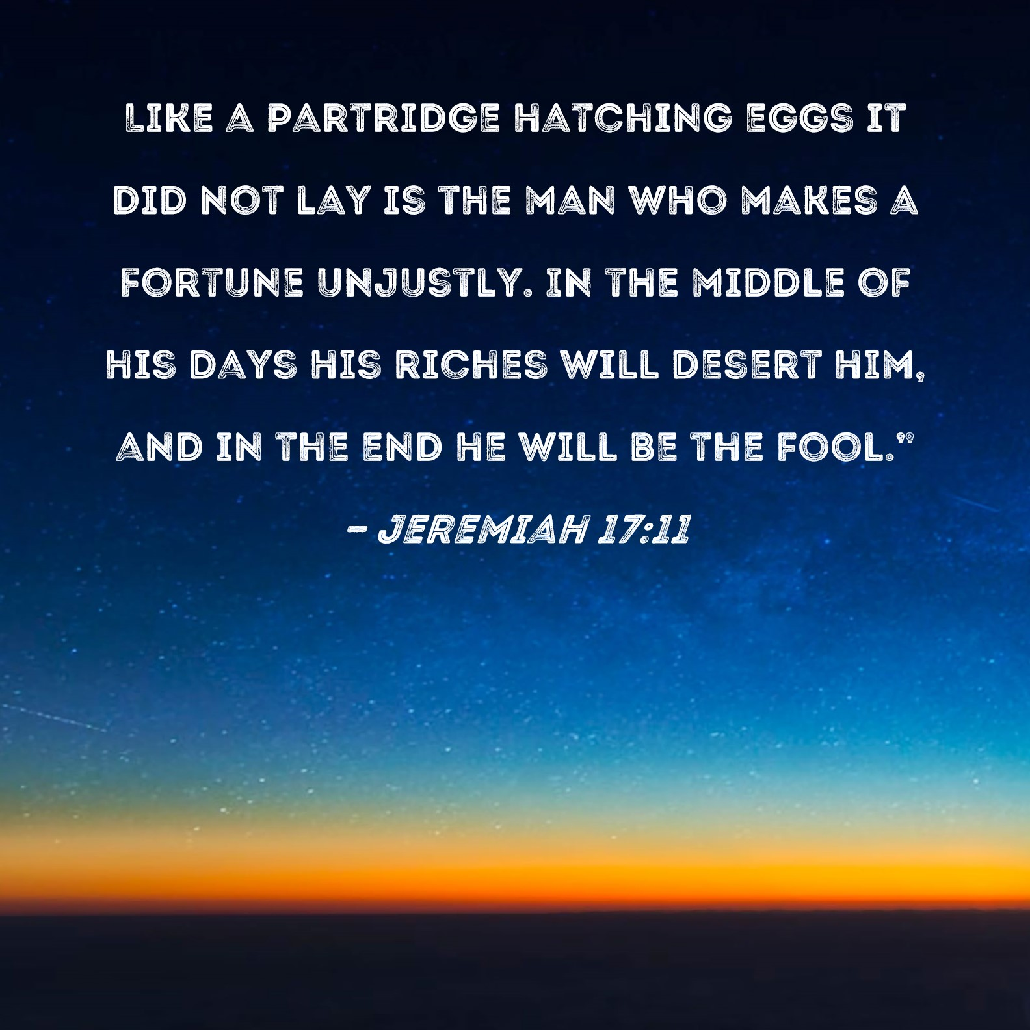

Slide 14
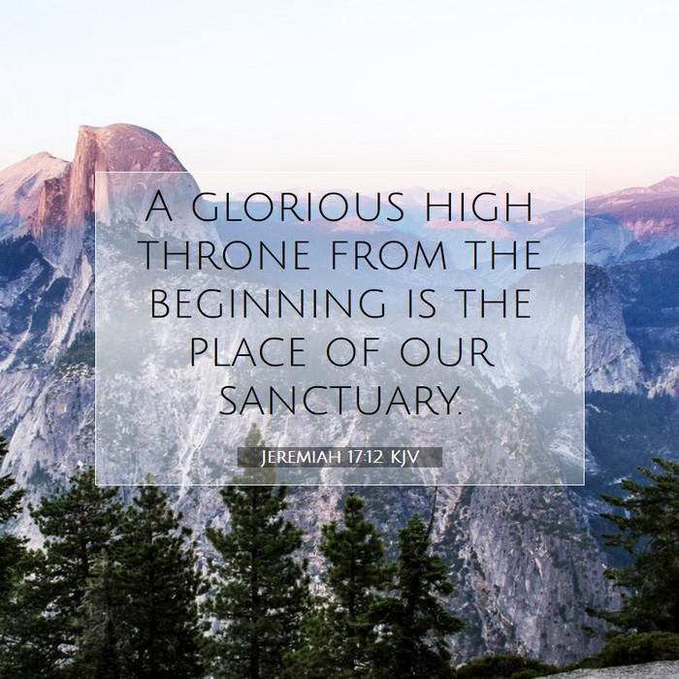

Slide 17
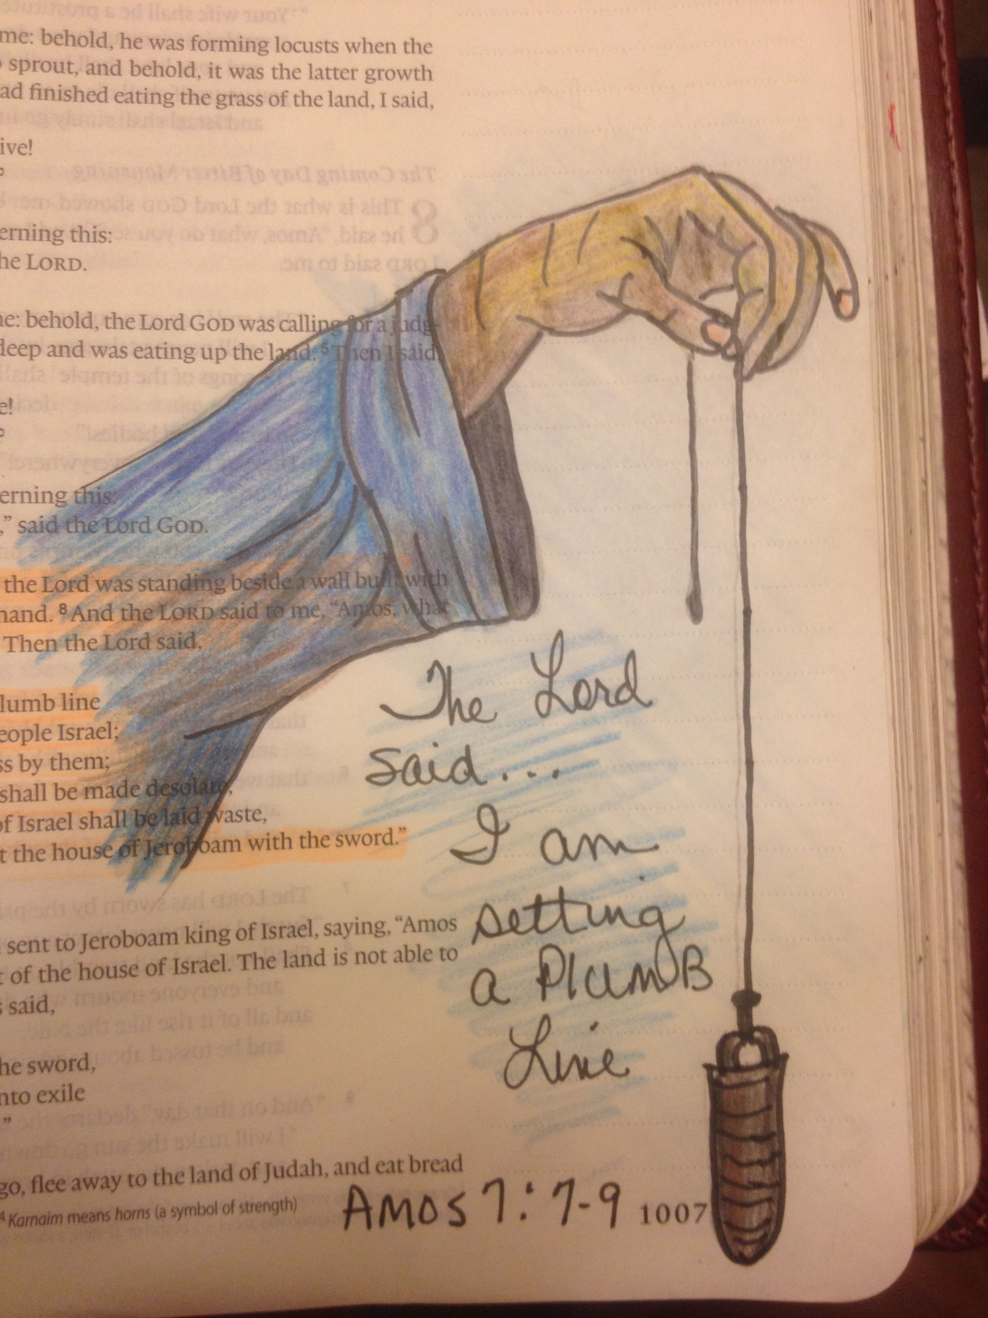

Slide 18
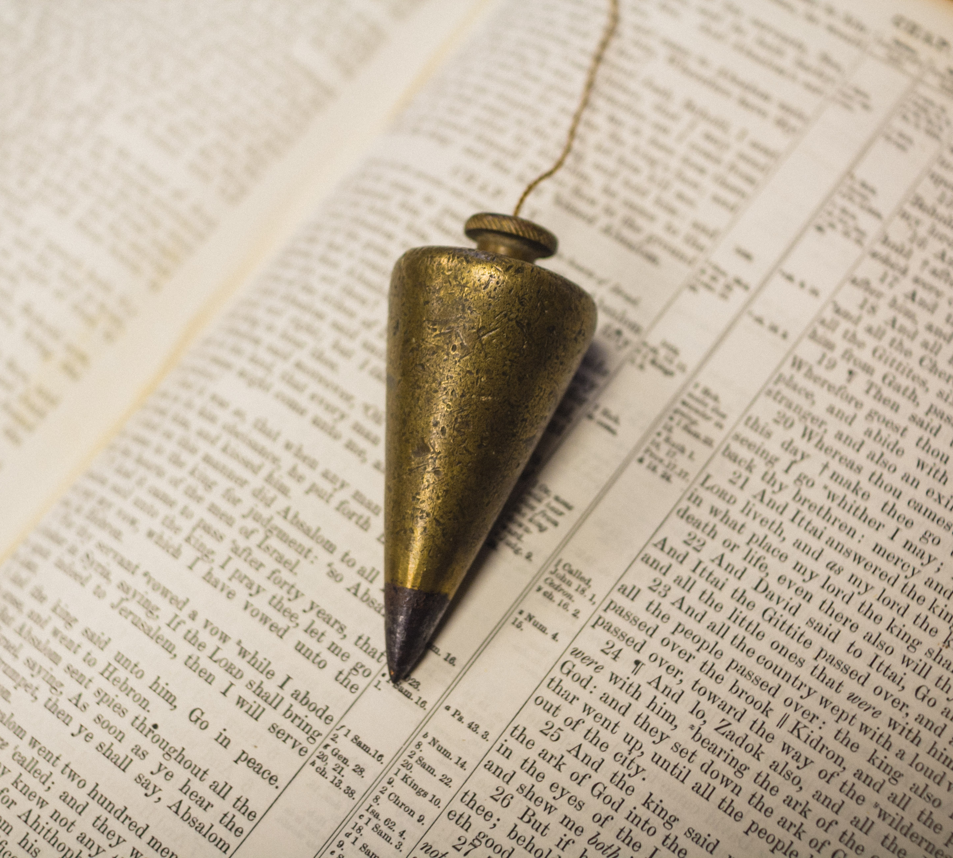

Slide 19
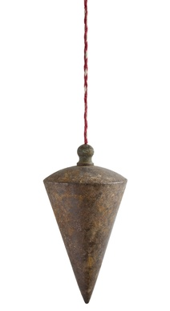
US AND GOD
US AND PEOPLE

Slide 20
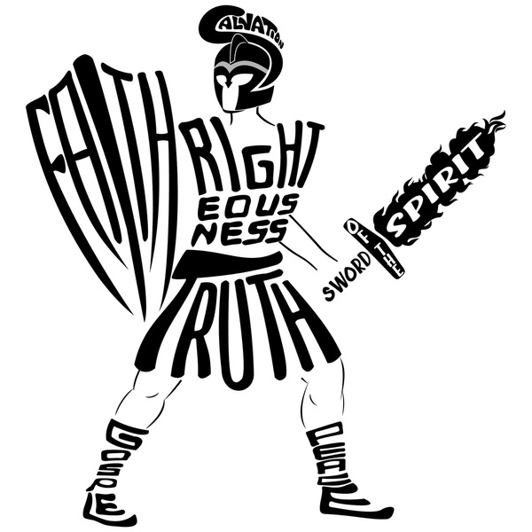

Slide 21
6:10-20

Slide 22
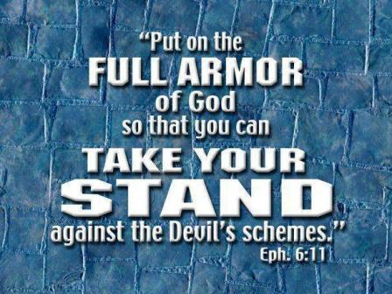

Slide 26
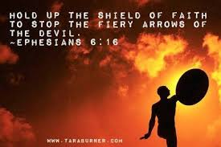

Slide 27
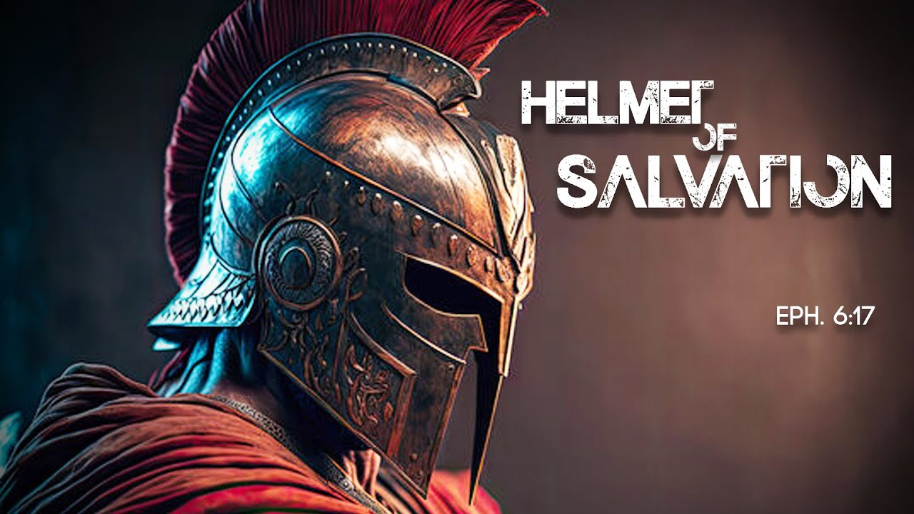

Slide 29
