Slide 2
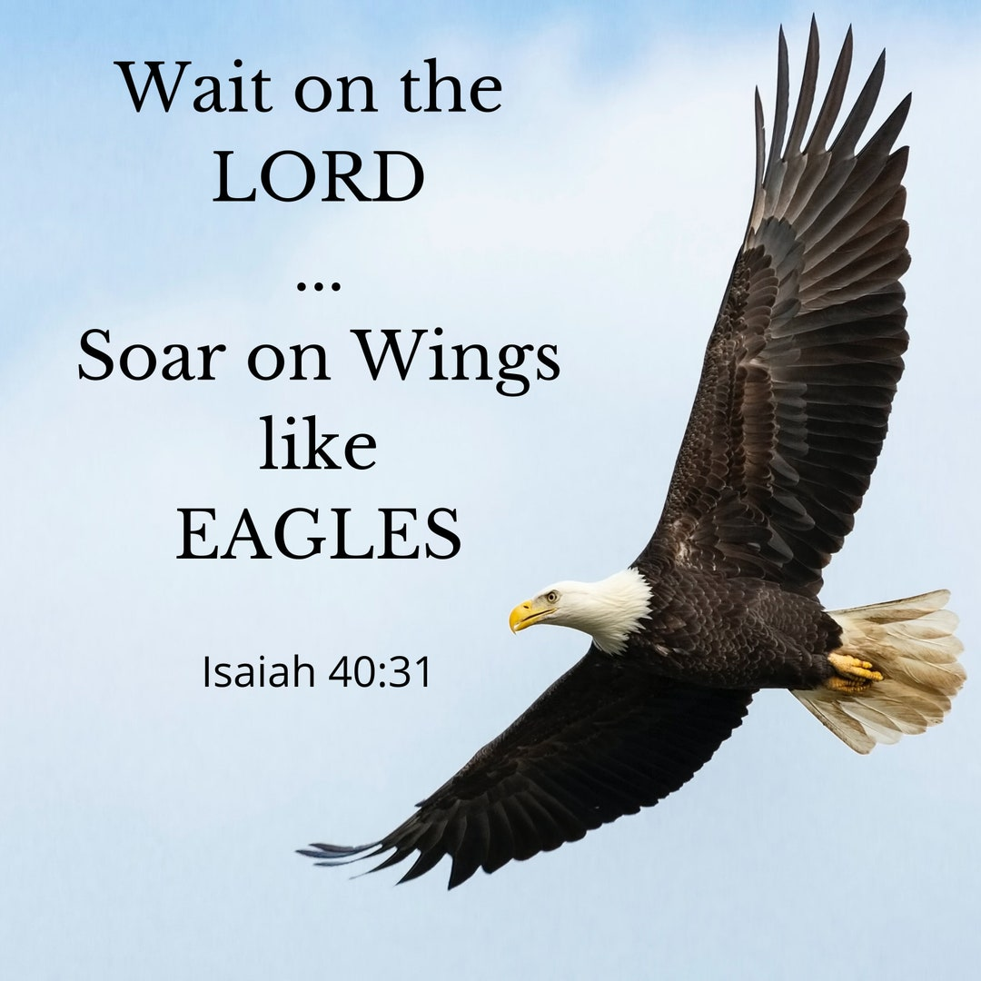
Learning to Fly Run walk
Isaiah 40:26-31

Slide 3
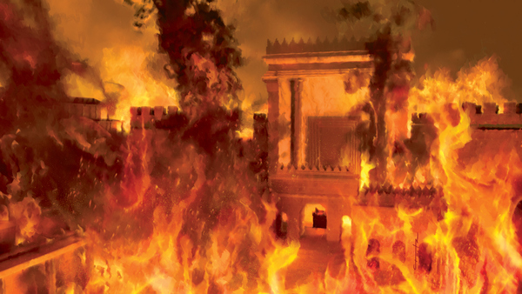

Slide 4
THE SOURCE FROM WHERE WE DERIVE OUR STRENGTH v27-28
THE SECRET FOR THOSE WHO DESIRE STRENGTH v29
THE SPHERES IN WHICH WE DISPLAY THIS STRENGTH v30-31

Slide 5
THE SOURCE FROM WHERE WE DERIVE OUR STRENGTH
V27-28

Slide 7
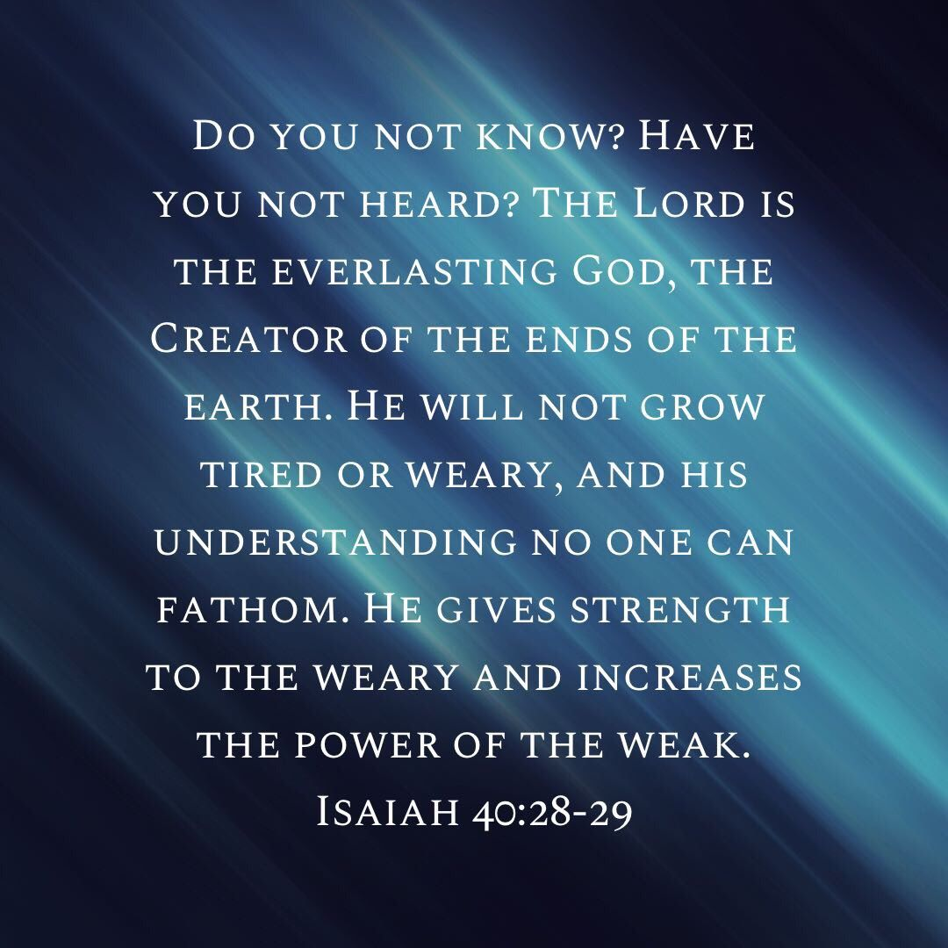

Slide 8
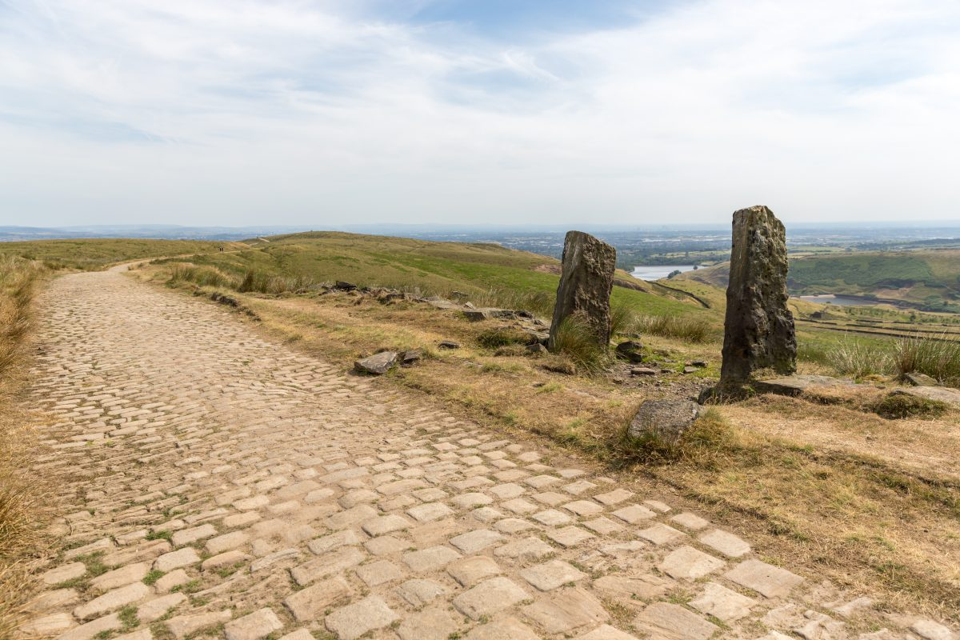

Slide 9
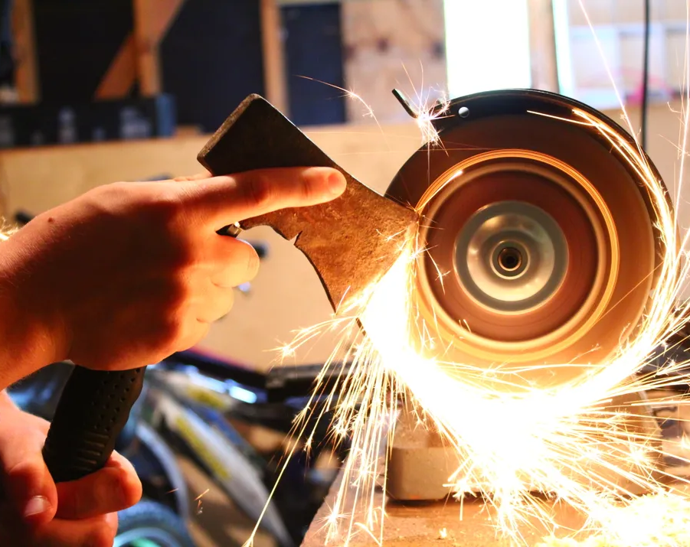
Eccles 10:10

Slide 10
THE SECRET FOR THOSE WHO DESIRE STRENGTH
V 29 -

Slide 11
THE SPHERES IN WHICH WE DISPLAY THIS STRENGTH
The ATMOSHPHERE OF HEAVEN “SOAR”

Slide 12
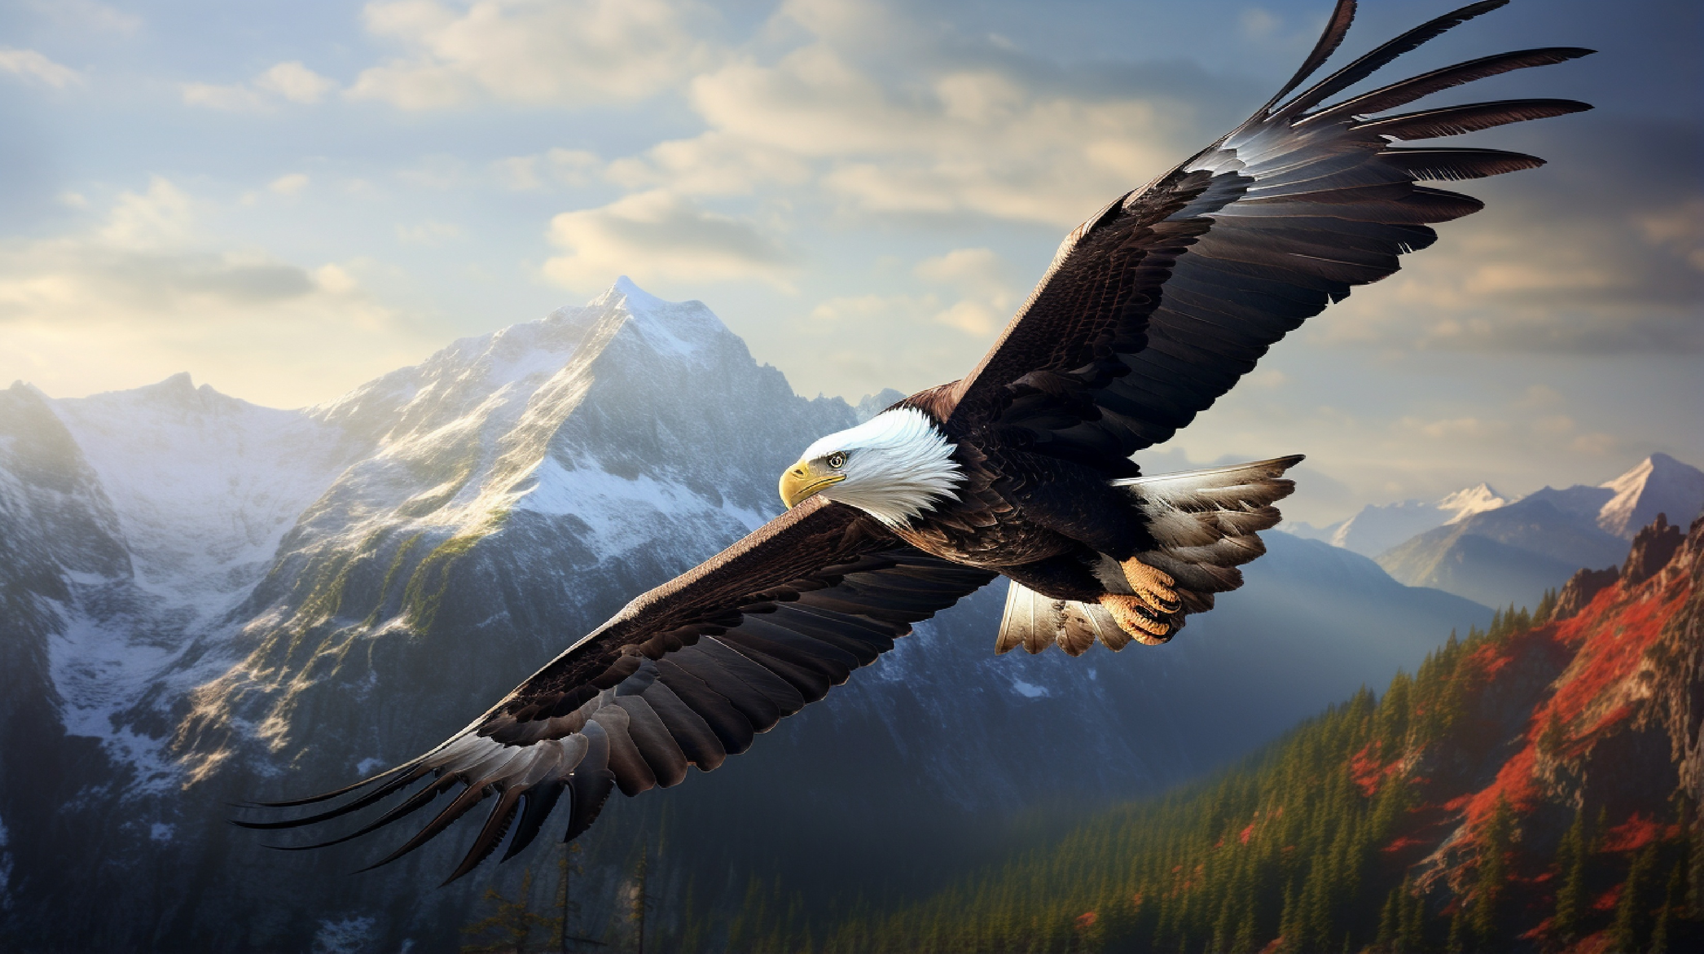

Slide 13
THE SPHERES IN WHICH WE DISPLAY THIS STRENGTH
The ATMOSHPHERE OF HEAVEN “SOAR”
THE ARENA OF FAITH “THEY RUN…”

Slide 15
THE SPHERES IN WHICH WE DISPLAY THIS STRENGTH
The ATMOSHPHERE OF HEAVEN “SOAR”
THE ARENA OF FAITH “THEY RUN…”
THE AVENUE OF DAILY LIFE “WALK & NOT FAINT”

Slide 17
HOW TO WAIT ON THE LORD
SILENTLY TO ENJOY COMMUNION Ps 62:1
PATIENTLY TO MAKE PETITION Ps 40:1
OBSERVANTLY TO HEAR INSTRUCTION Pro 8:33-34
EXPECTANTLY TO FIND PROTECTION Isa 33:2
OBEDIENTLY TO RECEIVE INSTRUCTION Ps 25:5

