Slide 2
Five things a Christian should not do

Slide 3
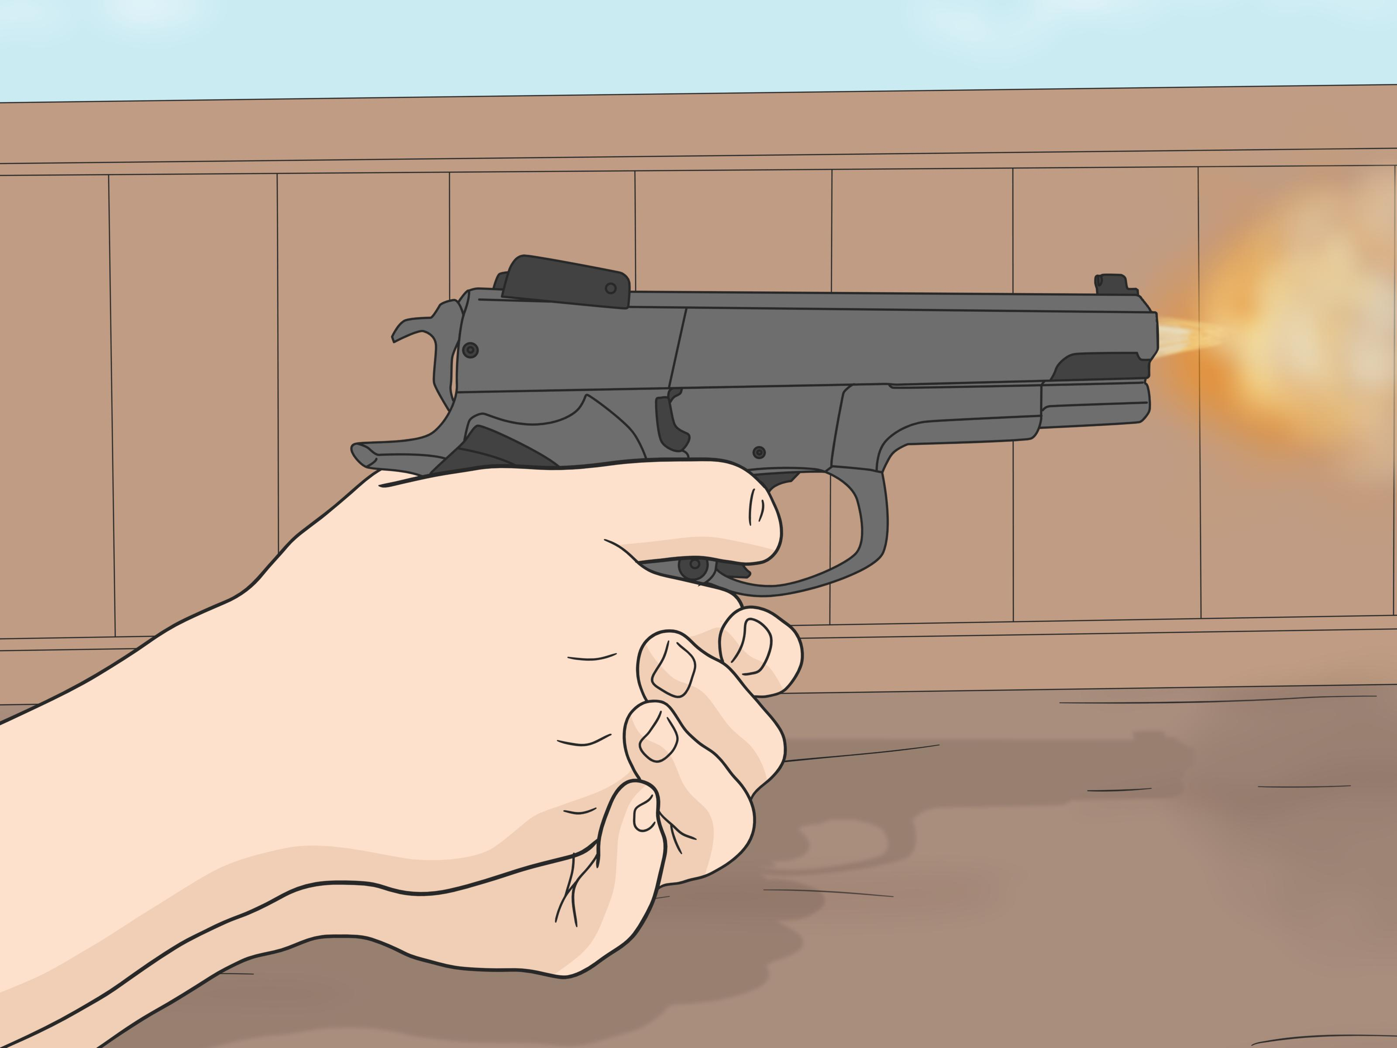
Murder
Theft
Adultery
Lying
Blasphemy

Slide 4
Going to the cinema
Using makeup
Going to pubs
Dancing
Playing football on a Sunday

Slide 5
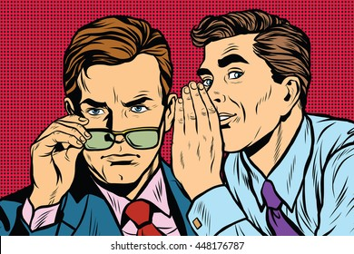
Sex before marriage
Gossiping
Swearing
Excessive eating & drinking
Selfish ambition

Slide 6
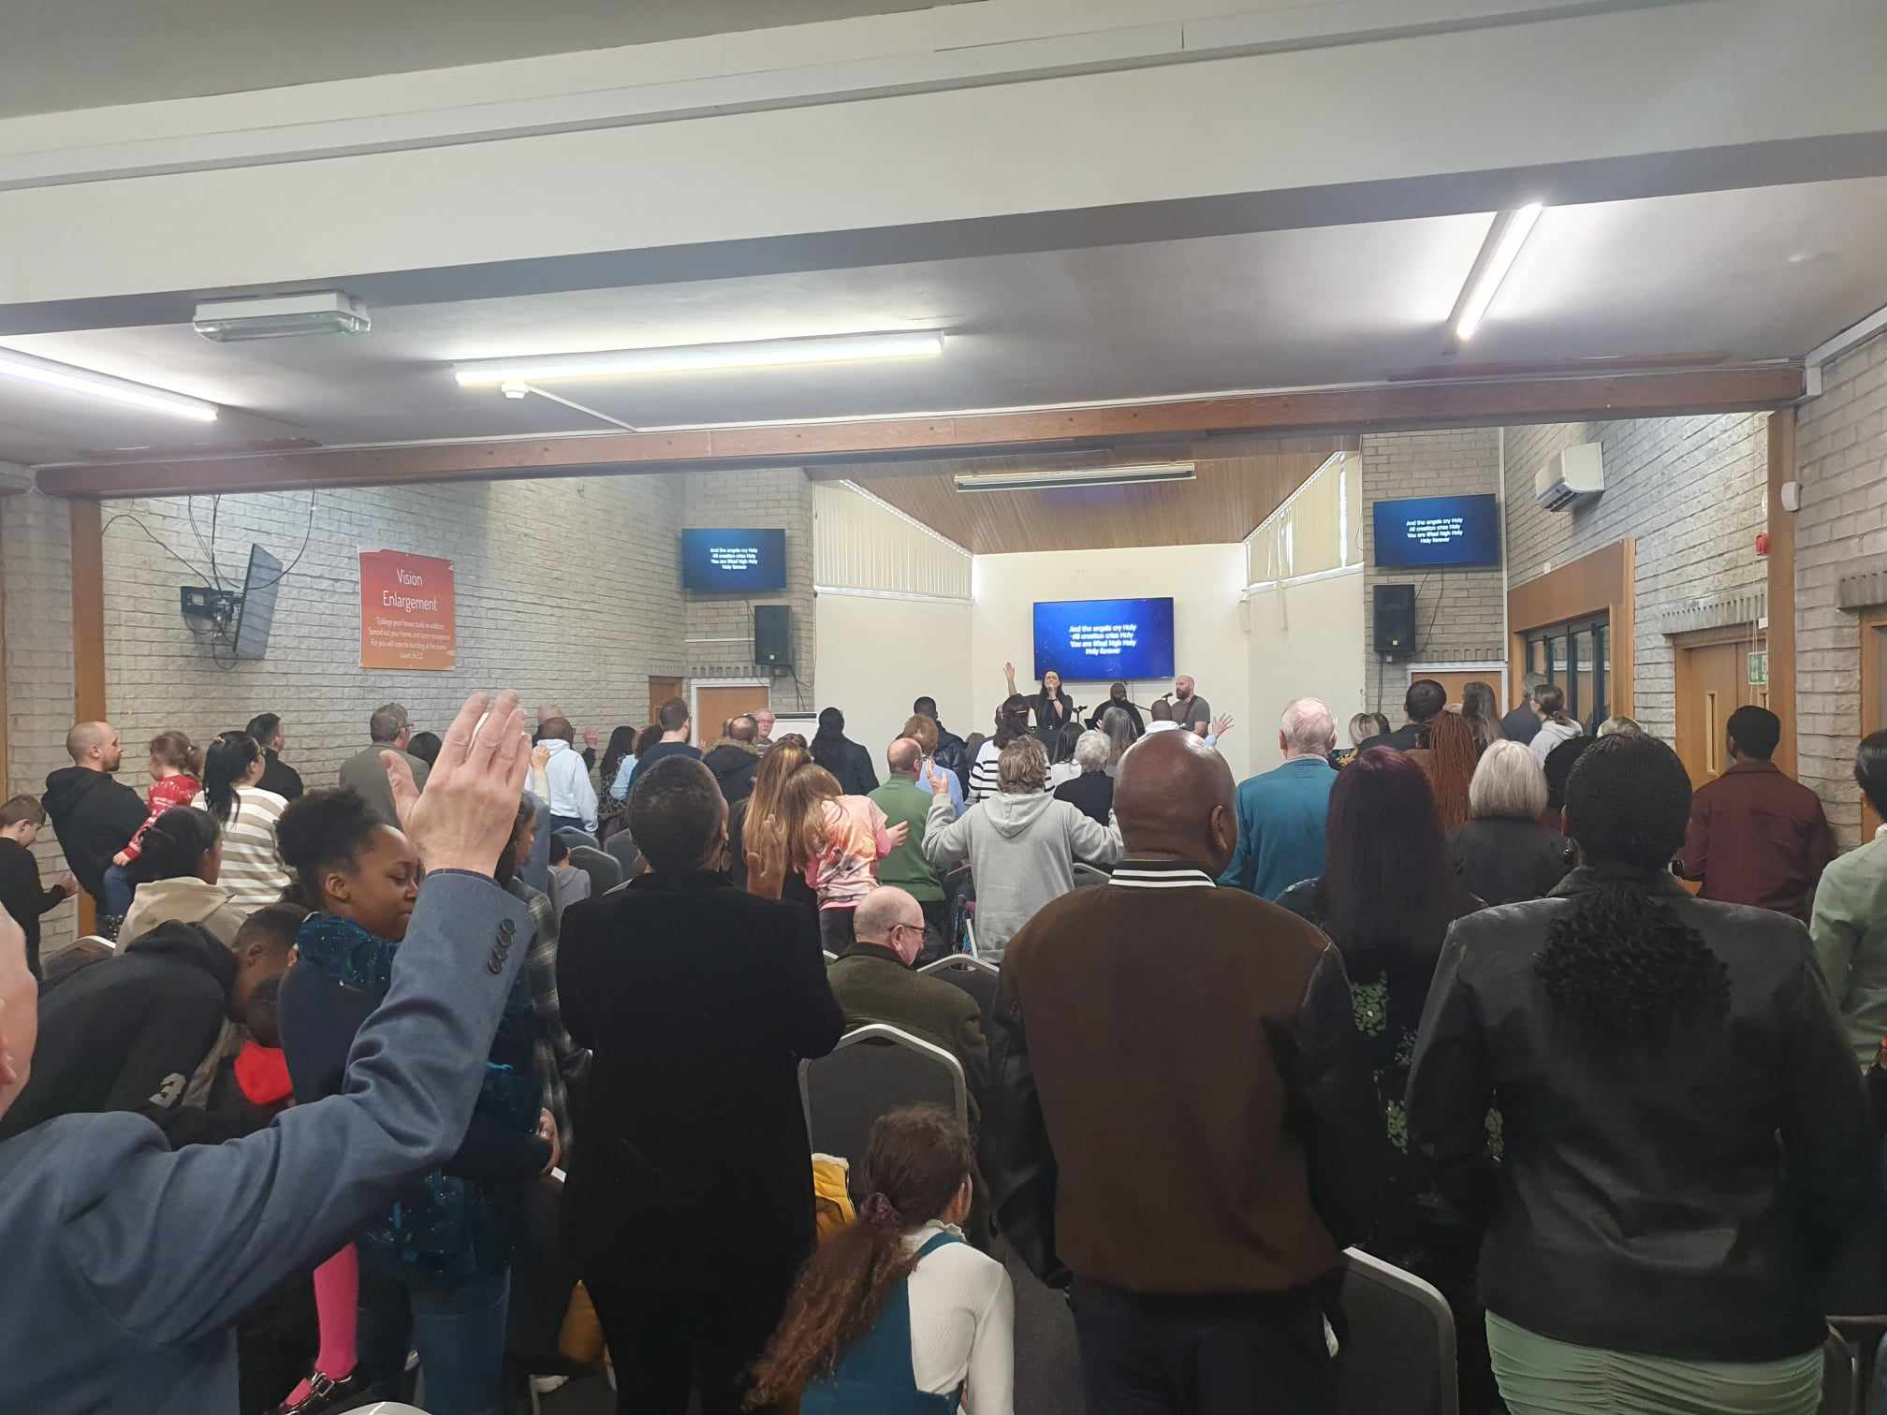
Reading the Bible
Meeting together
Worshipping
Giving
Praying

Slide 7
Don’t read the Bible

Slide 8
James 1 v 22-24
Do not merely listen to the word, and so deceive yourselves. Do what it says. Anyone who listens to the word but does not do what it says is like someone who looks at his face in a mirror and, after looking at himself, goes away and immediately forgets what he looks like.

Slide 10
How should we read the Bible?

Slide 11
Read it /listen to it regularly
Always pray before you read it that the Holy Spirit reveals God’s word to your mind and heart
Do what it says!
Remember:
2 Timothy 4 v 16 All Scripture is God-breathed and is useful for teaching, rebuking, correcting and training in righteousness
Hebrews 4 v 12 For the word of God is alive and active. Sharper than any double-edged sword, it penetrates even to dividing soul and spirit, joints and marrow; it judges the thoughts and attitudes of the heart.

Slide 12
Don’t worship

Slide 13
Matthew 15 v 8&9 – Jesus is quoting Isaiah 29 v 13
‘These people honour me with their lips, but their hearts are far from me. They worship me in vain; their teachings are merely human rules.’

Slide 14
How do we worship?

Slide 15
John 4 v 23&24
Yet a time is coming and has now come when the true worshippers will worship the Father in the Spirit and in truth, for they are the kind of worshippers the Father seeks. God is spirit, and his worshippers must worship in the Spirit and in truth.

Slide 16
Don’t meet together

Slide 17
1 Corinthians 11 v 17
In the following directives I have no praise for you, for your meetings do more harm than good.

Slide 18
How do we meet together?

Slide 19
Hebrews 10 v 24 &25 Let us consider how we may spur one another on toward love and good deeds, not giving up meeting together, as some are in the habit of doing, but encouraging one another—and all the more as you see the Day approaching.

Slide 20
Don’t give

Slide 21
Matthew 6 v 1-4
Be careful not to practice your righteousness in front of others to be seen by them. If you do, you will have no reward from your Father in heaven.
So when you give to the needy, do not announce it with trumpets, as the hypocrites do in the synagogues and on the streets, to be honoured by others. Truly I tell you, they have received their reward in full. But when you give to the needy, do not let your left hand know what your right hand is doing, so that your giving may be in secret. Then your Father, who sees what is done in secret, will reward you.

Slide 22
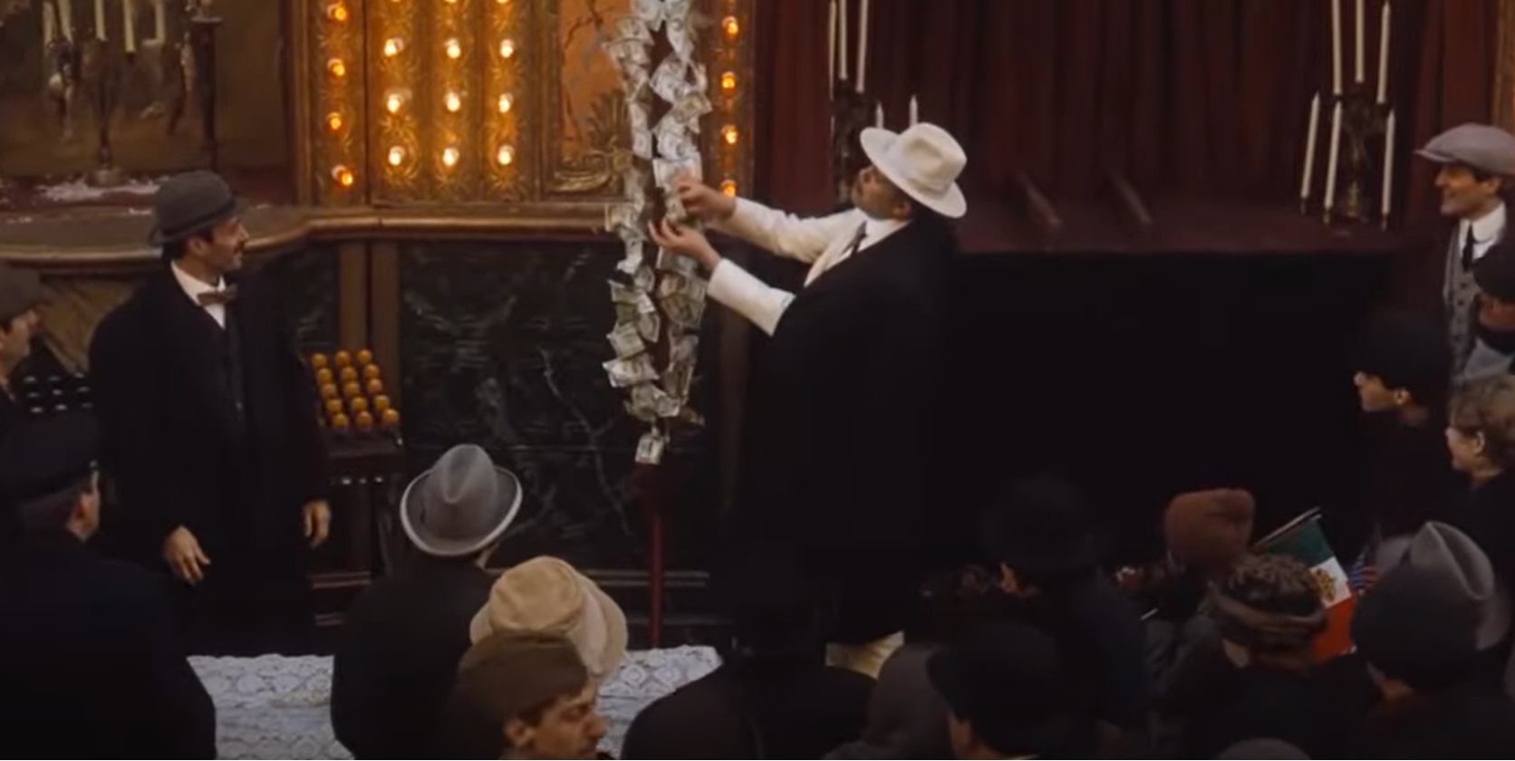

Slide 24
How do we give?

Slide 25
1 Corinthians 16 v 1 &2 Now about the collection for the Lord’s people: Do what I told the Galatian churches to do. On the first day of every week, each one of you should set aside a sum of money in keeping with your income, saving it up, so that when I come no collections will have to be made
2 Corinthians 9 v 6&7 Remember this: Whoever sows sparingly will also reap sparingly, and whoever sows generously will also reap generously. Each of you should give what you have decided in your heart to give, not reluctantly or under compulsion, for God loves a cheerful giver.

Slide 26
Don’t pray

Slide 27
James 4 v 2&3
You do not have because you do not ask God. When you ask, you do not receive, because you ask with wrong motives, that you may spend what you get on your pleasures.

Slide 28
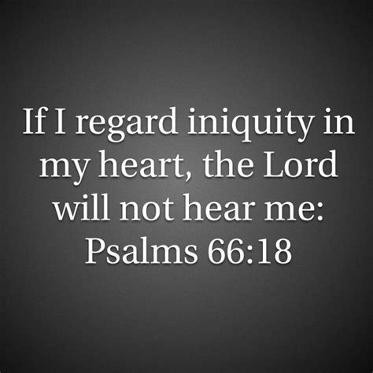
Sin

Slide 29
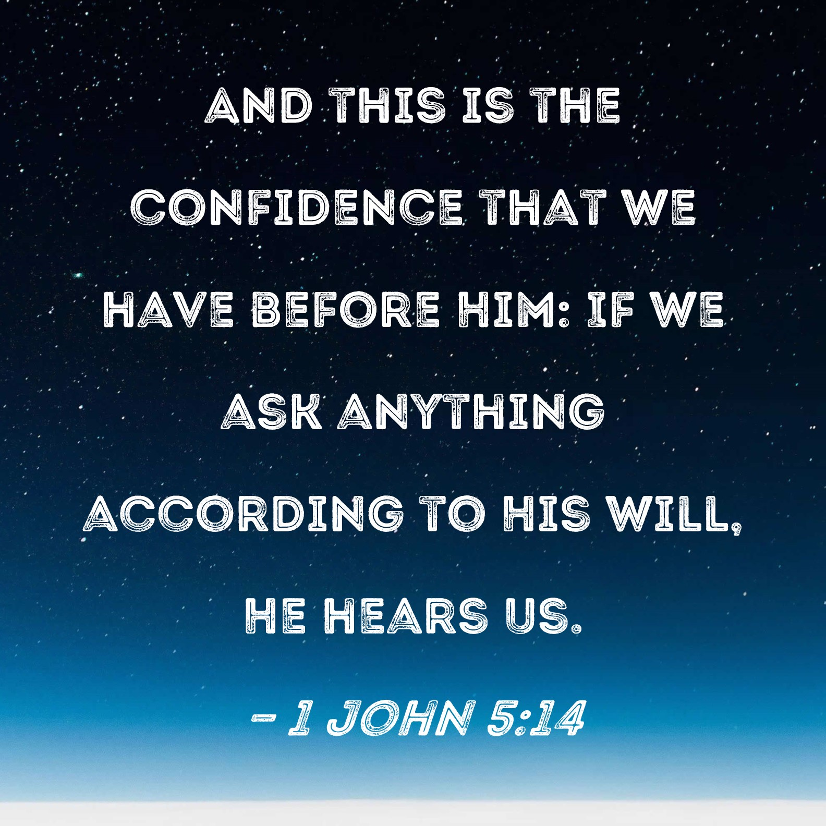
Not in God’s will

Slide 30
Lack of faith

Slide 31
How do we pray?

Slide 32
James 4 v 2&3
You do not have because you do not ask God. When you ask, you do not receive, because you ask with wrong motives, that you may spend what you get on your pleasures.

Slide 33
Pray with the right motive!
Confess any sin in your heart so you will be forgiven so God will hear your prayers
Spend time with Him so your prayers will be according to his will.
Have belief and confidence that He hears and will answer every prayer

Slide 34
Hebrews 4 v 16 Let us then approach God’s throne of grace with confidence, so that we may receive mercy and find grace to help us in our time of need.

Slide 35
Matthew 7 v 7-11
“Ask and it will be given to you; seek and you will find; knock and the door will be opened to you. For everyone who asks receives; the one who seeks finds; and to the one who knocks, the door will be opened.
“Which of you, if your son asks for bread, will give him a stone? Or if he asks for a fish, will give him a snake? If you, then, though you are evil, know how to give good gifts to your children, how much more will your Father in heaven give good gifts to those who ask him!’’

Slide 36
Reading the Bible
Meeting together
Worshipping
Giving
Praying

