Slide 1
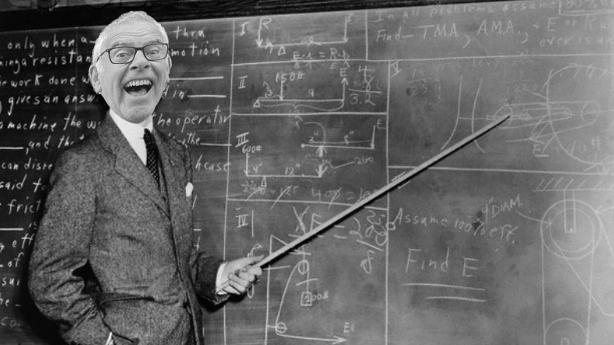
Back To
School

Slide 2
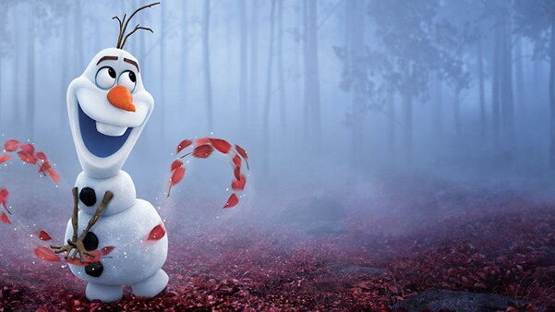
I’m just living the dream Anna, oh how I wish this could last forever.
And yet change mocks us with her beauty!
Do you ever worry about the notion that nothing is permanent?

Slide 3
grow

Slide 4
challenge

Slide 5
cost

