Slide 2
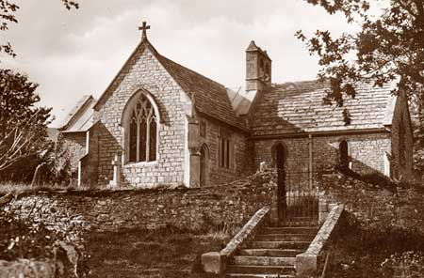
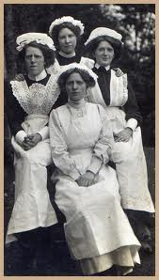

Slide 3
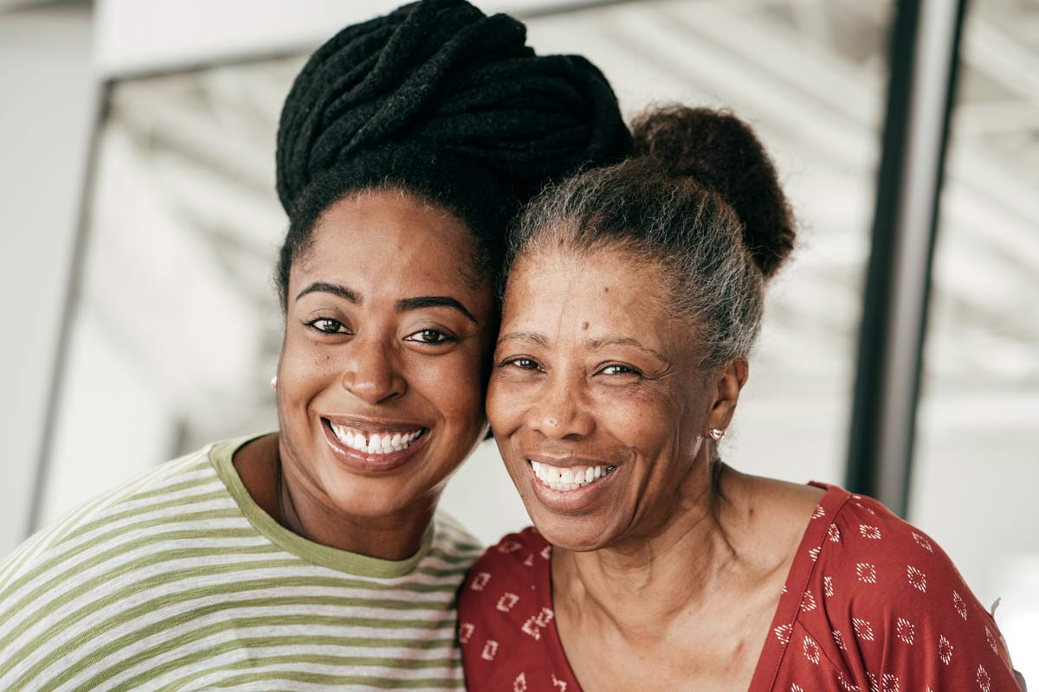
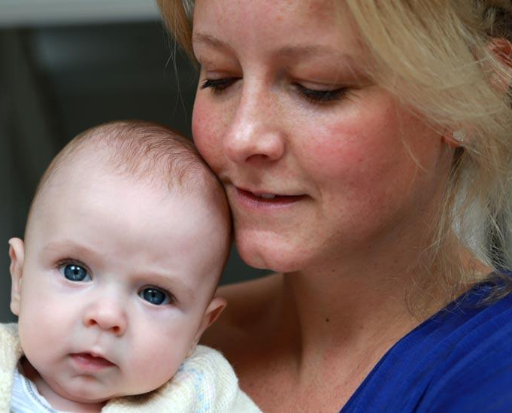
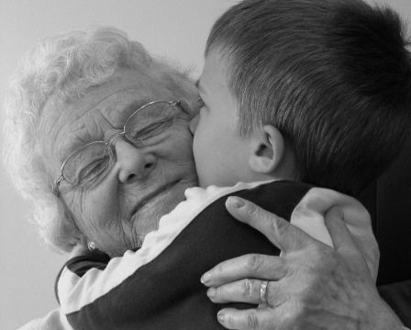
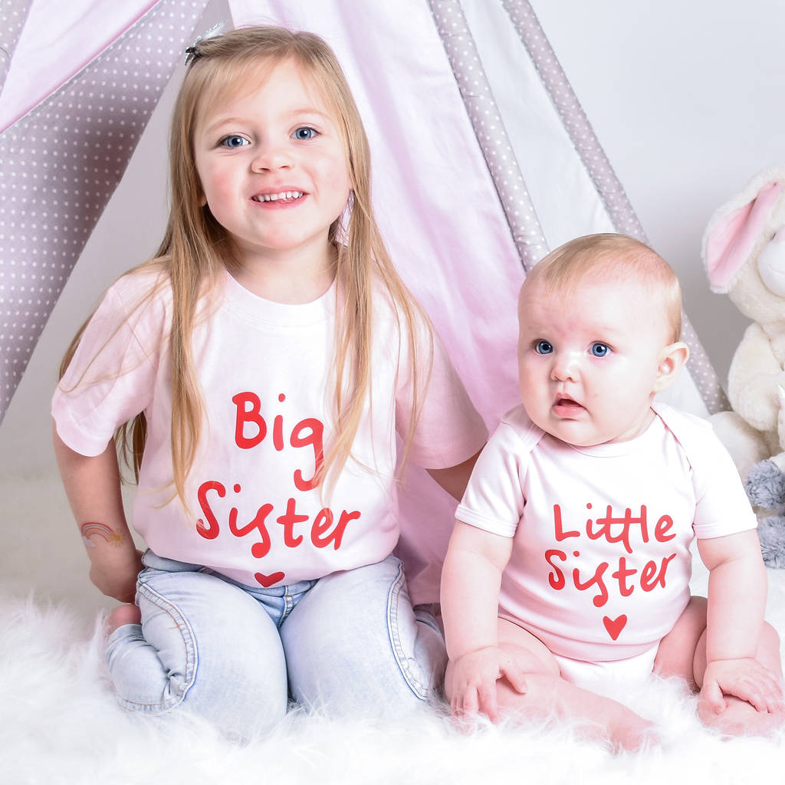
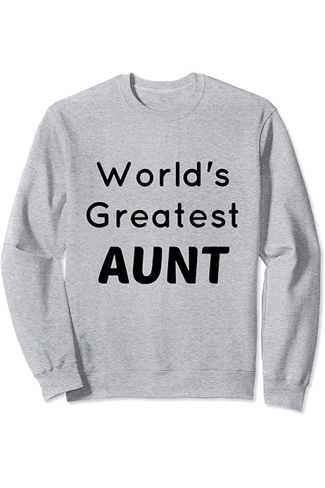

Slide 6
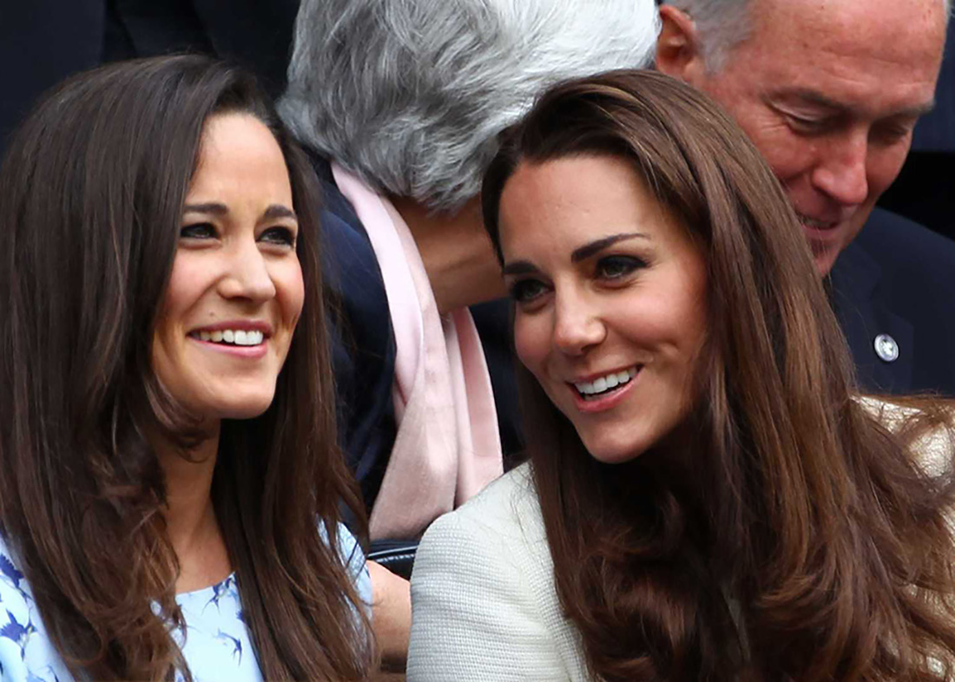
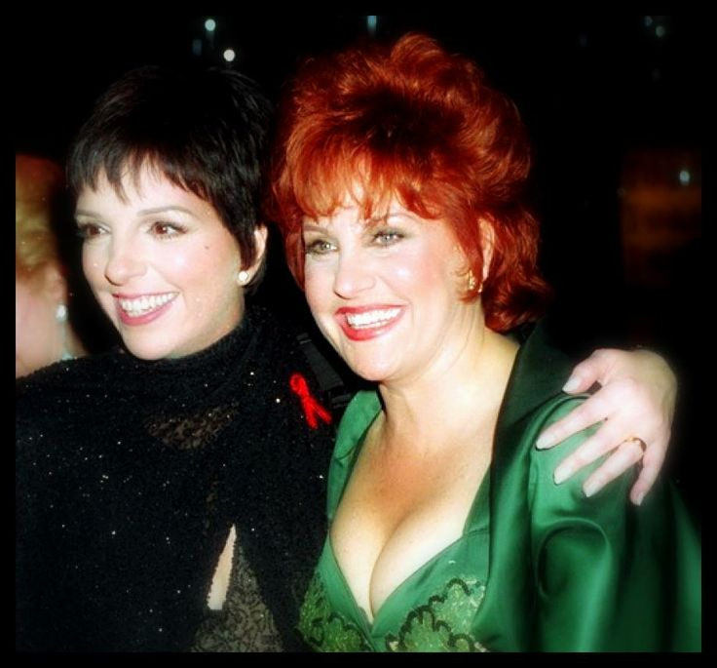

Slide 7
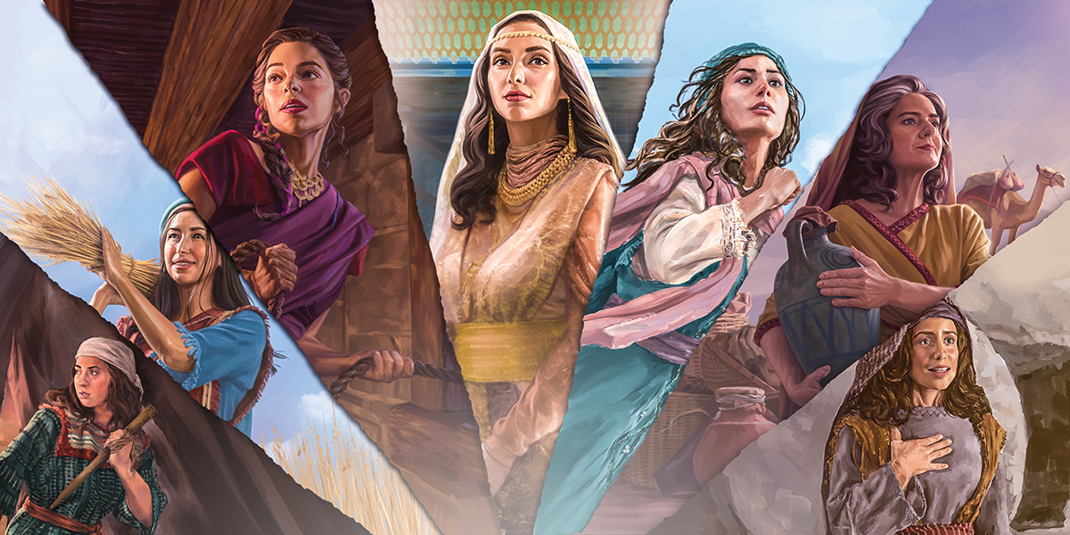

Slide 8
D
A
U
G
T
H
E
R
M
O
T
H
E
R
EVE, SARAI, MILCAH, HAGAR, REBEKAH, KETURAH, RACHEL, LEAH, BILHAH, ZILPAH, DINAH, ADAH, OHOLIBAMAH, BASEMATH, TIMNA, TAMAR, ASANATH, ZIPPORAH, MIRIAM, COZBI, MAHLAH, NOAH, HOGLAH, MIRZAH, RAHAB, ACSAH, DEBORAH, JAEL, DELILAH, NAOMI, ORPAH, RUTH, HANNAH, PENINNAH, MERAH, MUCHAL, AHINOAM, ABIGAIL, RIZPAH, MICAL, BATHSHEBA, TAMAR, ABISHAG, HAGGITH, TAHPENES, MAACAH, JEZEBEL, AZUBAH, ATHALIAH, JEHOSHEBA, ZIBIAH, JOHOADDIN, JECOLIAH, ABIJAH, HEPHZIBAR, MESHALLEMETH, JEDIDAH, HULDAH, HAMITAL, ZEBIDAH, NEHUSHTA, EPHAH, EGLAH, SHALOMITH, NAARAH, BILHIAH, SHUA, BAARA, HODESH, HUSHIM, MIRIA,
NAAMAH, SHIMEATH, SHIMRATH, SHEERAH, HEZZELEPONI
MARY, MARY MAGDALENE, MARY MOTHER OF JAMES/JOSES, MARY WIFE OF CLOPAS, MARY MPTHER OF JOHN, “OTHER MARY”, HERODIAS, SALOME, ELIZABETH, JOANNA, MARY & MARTHA, SUSANNA, SAPPHIRA, CANDACE, RHODA, LYDIA, PRISCILLA, BERNICE, EUODIA, SYNTYCHE, NYMPHA, CLAUDIA, LOIS, EUNICE, HYMENAEUS, PHILITUS,
WIFE
COUSIN
SISTER

Slide 10
The Lord announces the word, and the women who proclaim it are a mighty throng: PSALM 68:11
Her children arise and call her blessed; her husband also, and he praises her: “Many women do noble things, But you surpass them all.” Charm is deceptive, and beauty is fleeting; but a woman who fears the Lord is to be praised. PROVERBS 31:28-30
..the procession of my God and King into the sanctuary. In front are the singers, after them the musicians; With them are the young women playing the timbrels. Praise God in the great congregation….
PSALM 68:24-6
They will come and shout for joy on the heights of Zion; they will rejoice in the bounty of the Lord… Then young women will dance and be glad….I will turn their mourning into gladness; I will give them comfort and joy instead of sorrow. JEREMIAH 12:12-4
Even on my servants, both men and women, I will pour out my Spirit in those days. JOEL 2:29

Slide 11
Many women were there, watching from a distance. They had followed Jesus from Galilee to care for his needs. MATTHEW 27:55
A friend loves at all times….. PROVERBS 17:17
As iron sharpens iron, so one person sharpens another. PROVERBS 27:17
.. Jesus traveled about from one town and village to another, proclaiming the good news of the kingdom of God. The Twelve were with him, and also some women who had been cured of evil spirits and diseases: Mary Magdalene, Joanna the wife of Chuza, the manager of Herod’s household; Susanna; and many others. These women were helping to support them out of their own means.
LUKE 8: 1-3
Greater love has no one than this: to lay one’s life for one’s friends. JOHN 15:13
Therefore encourage and build each other up just as in fact you are doing 1THESS 5:11

Slide 12
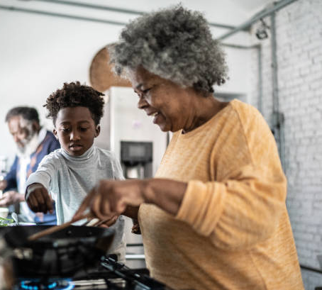
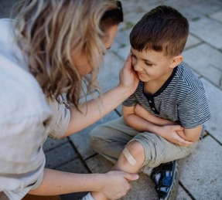

Slide 13
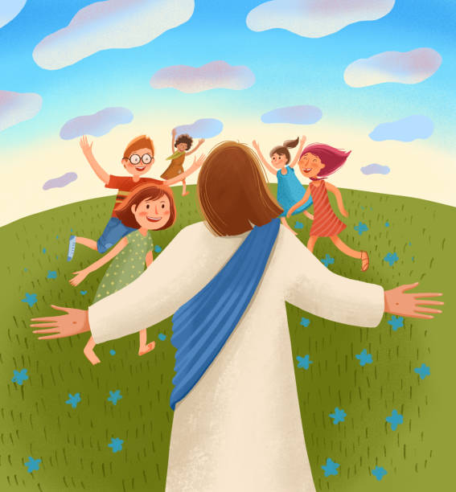
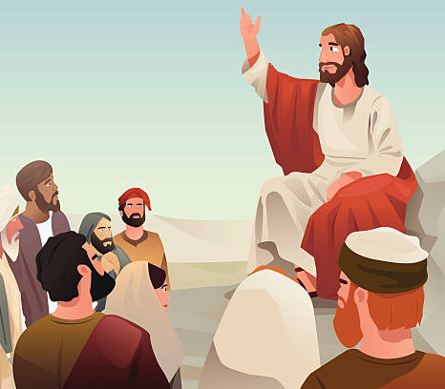
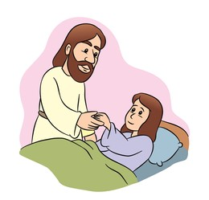

Slide 16
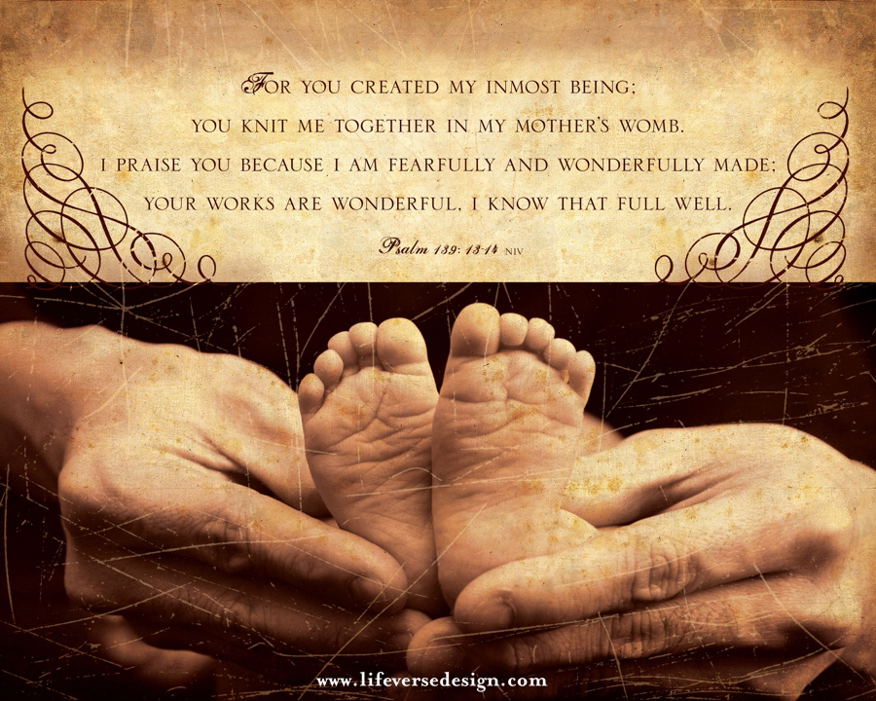

Slide 22
