Slide 1
WHIPPING UP A STORM
John 2:13-22

Slide 2
IS IT TIME TO CLEANSE THE TEMPLE?
John 2:13-22

Slide 3
A. THE BACKGROUND
John 2:14-15
Matt 21:12-13

Slide 4
B. THE CLEANSING OF THE TEMPLE
1. Jesus Enters the Temple
2. Jesus is Angry
3. Jesus Drives people out of the Temple
4. Jesus Speaks Isa. 56:7

Slide 6
B. THE CLEANSING OF THE TEMPLE
1. Jesus Enters the Temple
2. Jesus is Angry
3. Jesus Drives people out of the Temple
4. Jesus Speaks Isa. 56:7
5. Then Jesus Teaches

Slide 7
C. HOW HAVE WE ROBBED GOD?
MALACHI 3:8
IN NOT GIVING TO GOD’S HOUSE

Slide 8
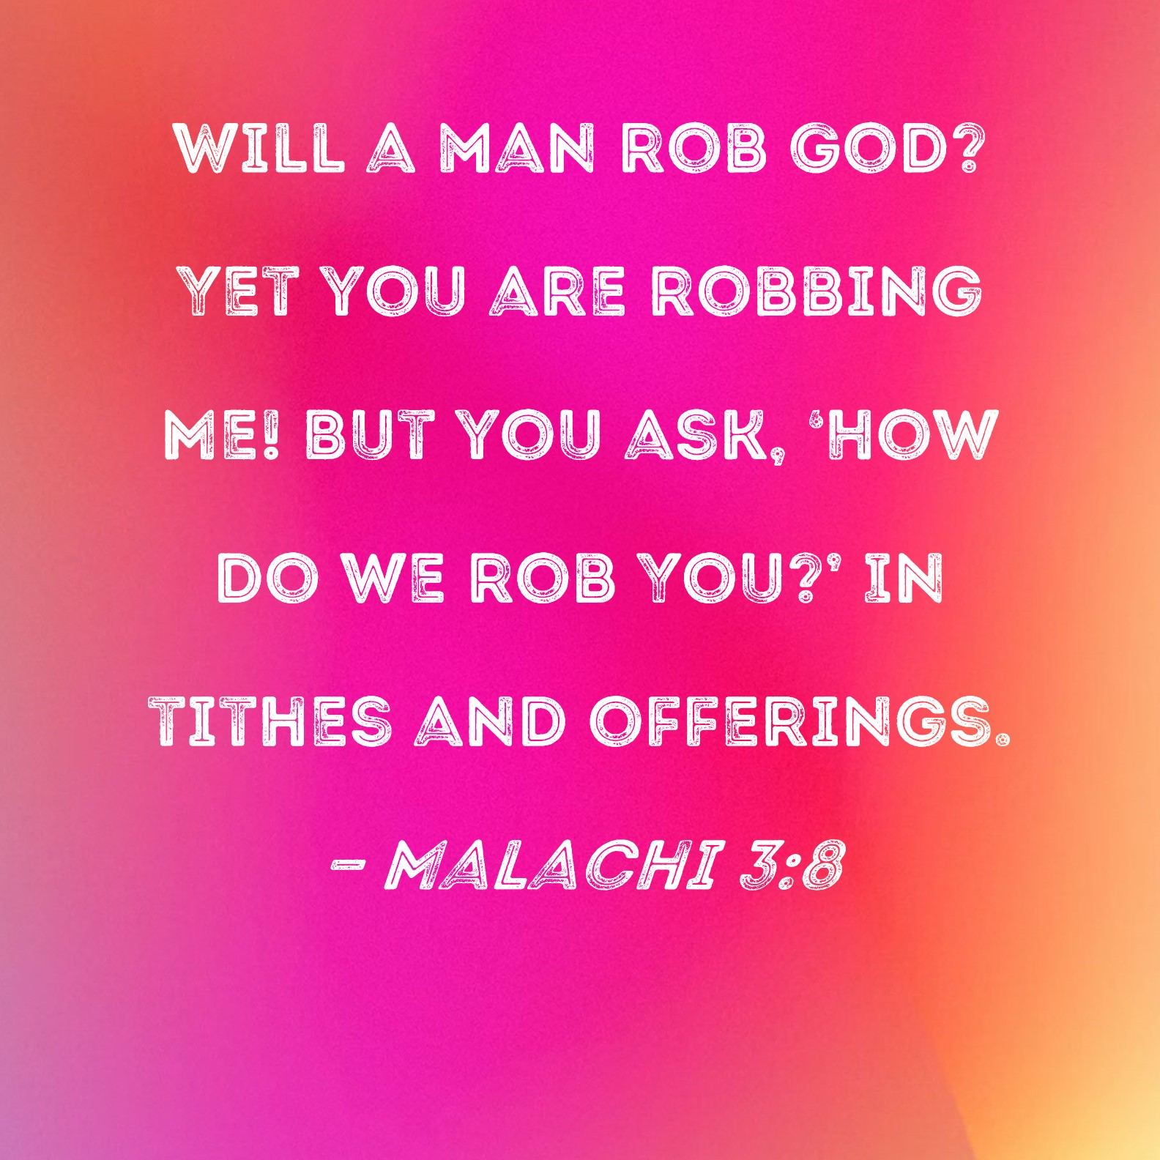
C. HOW HAVE WE ROBBED GOD?
Malachi 3:8

Slide 9
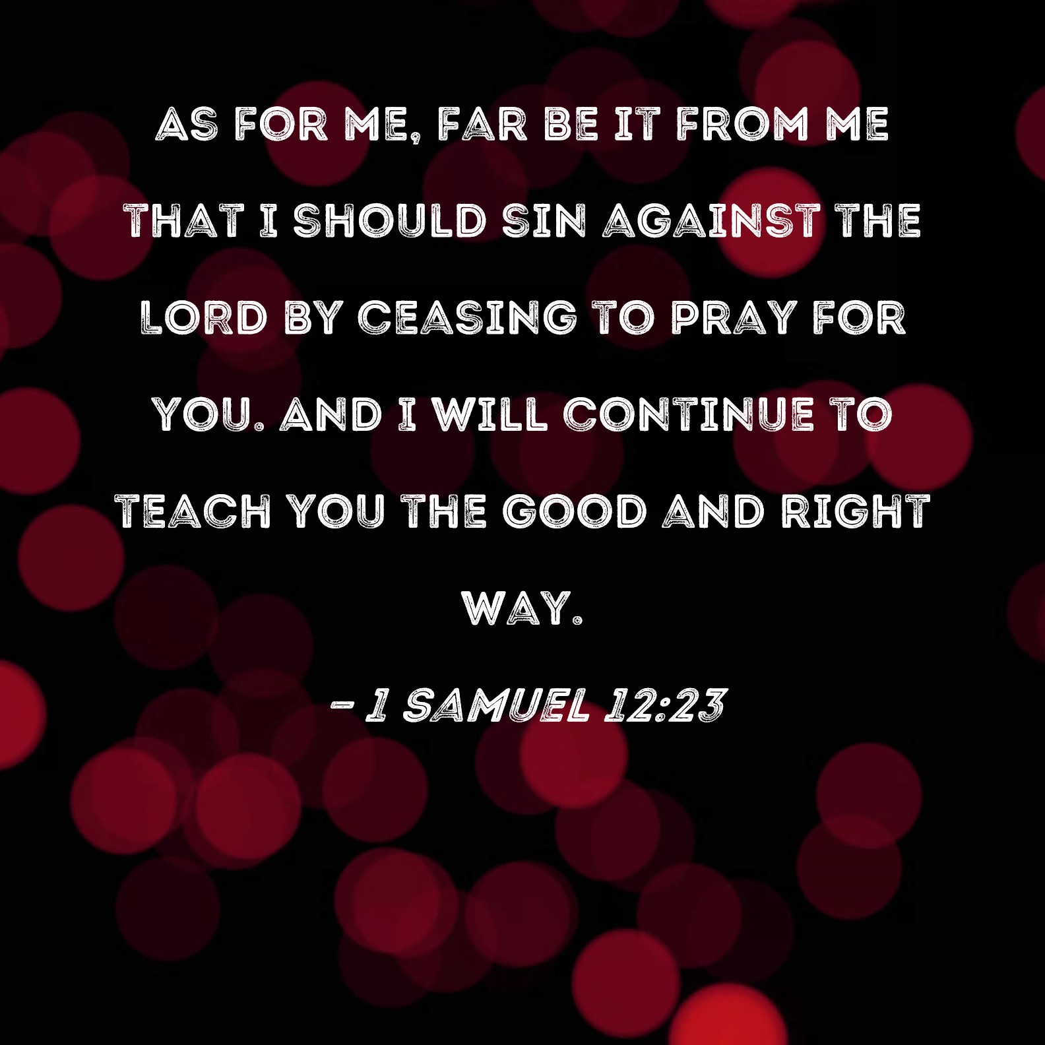
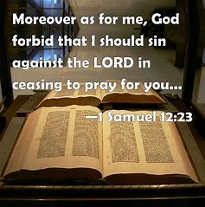
C. HOW HAVE WE ROBBED GOD?
MALACHI 3:8 GIVING TO GOD’S HOUSE
FAILING TO PRAY
FAILING TO PRAY TOGETHER

Slide 10
D. ACTION & E. PRAYER
Receive correction & rebuke
Receive cleansing 1 John 1:9
1 Cor.6:19
1Cor. 3:16

